Slide 1
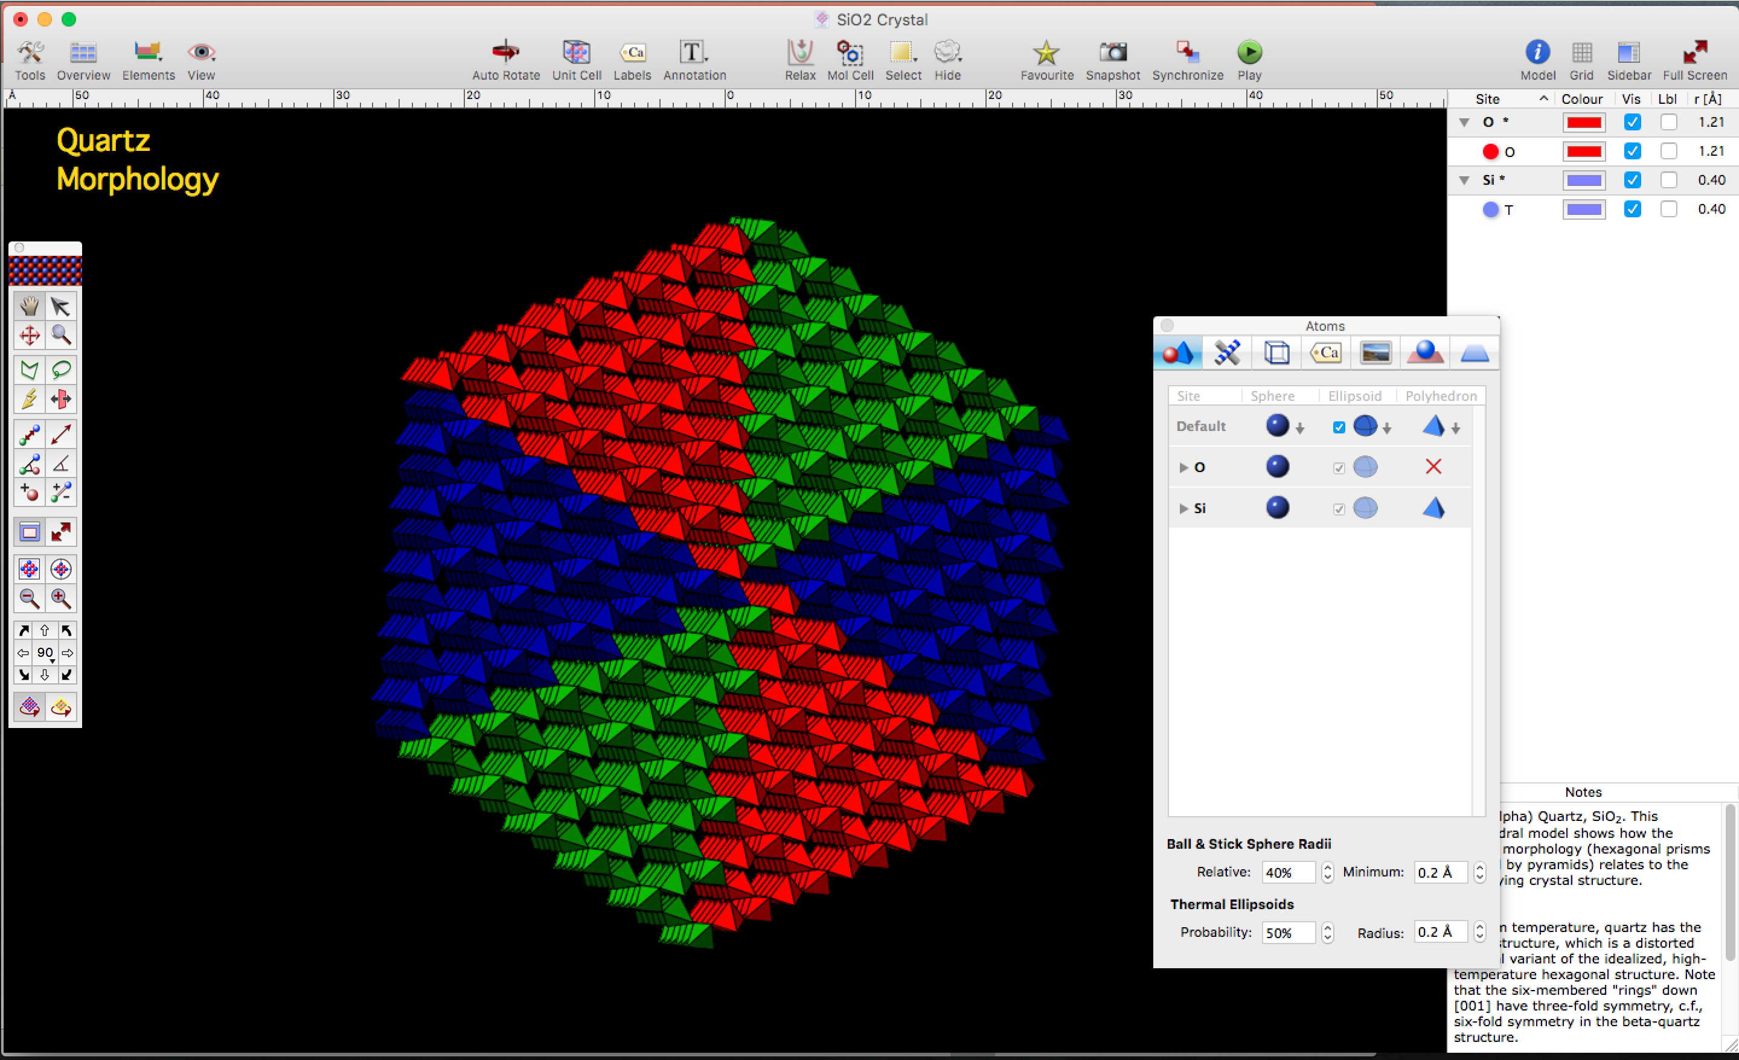




Visualizing Macro- and Microscopic Properties of Minerals Using Crystal Maker
Mark Williamson

Slide 2
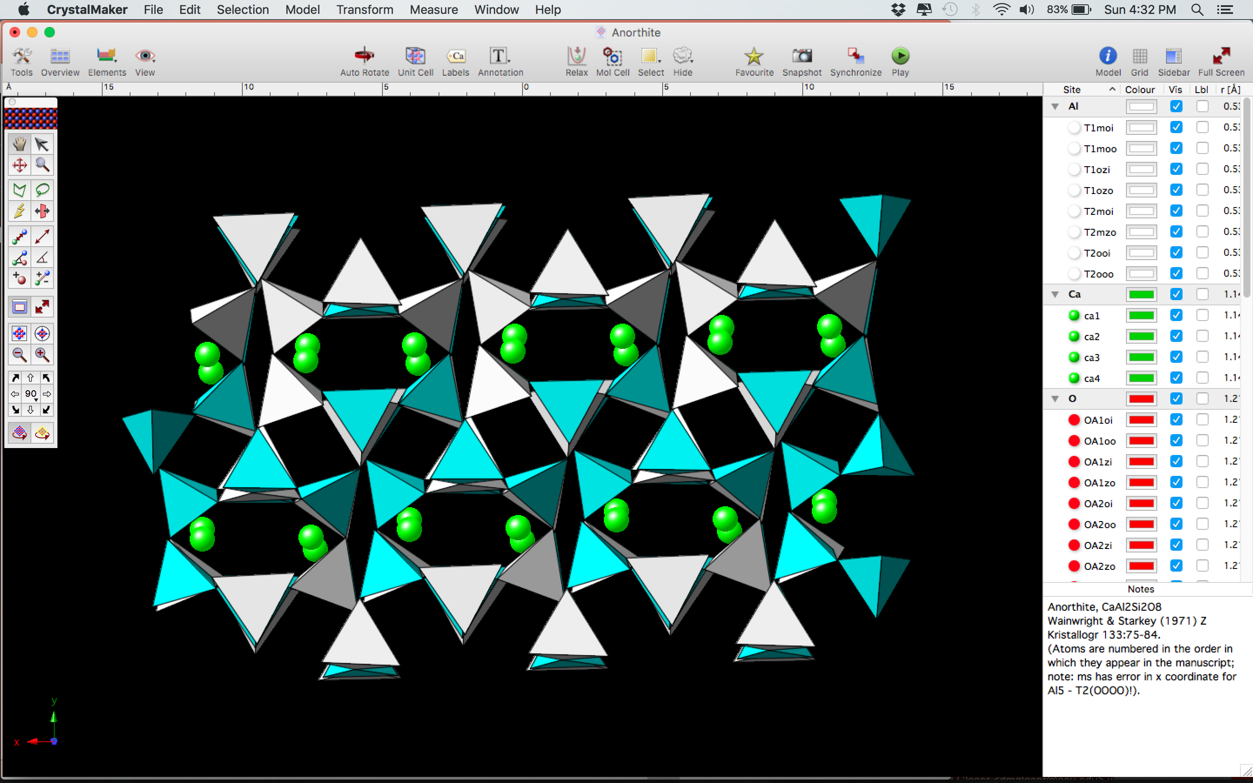
Introduction
The general public is mostly unaware of the microscopic structure of the world around them.
Most solid materials have crystalline structures.
We want to allow the public the opportunity to visualize the microscopic world around them.
Visualization is important for understanding structure, and structure is important for understanding materials.
We want to allow audiences to become more familiar with a topic they might otherwise consider to be too difficult or “scary.”

Slide 3
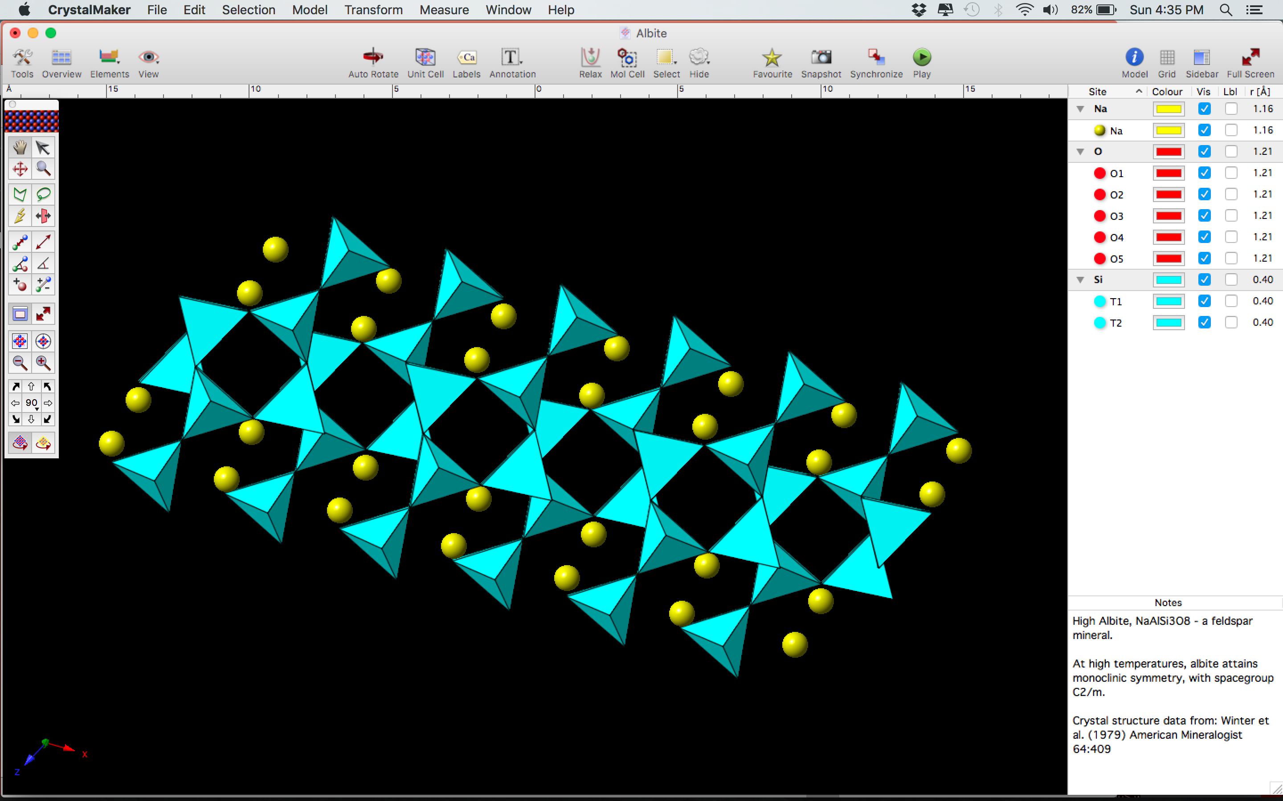
Now Let Me Show You!
To make things easier, we show audiences the notation that mineralogists and crystallographers use for showing atom positions.
Let’s take a look at the structure of a common mineral, quartz.

Slide 4
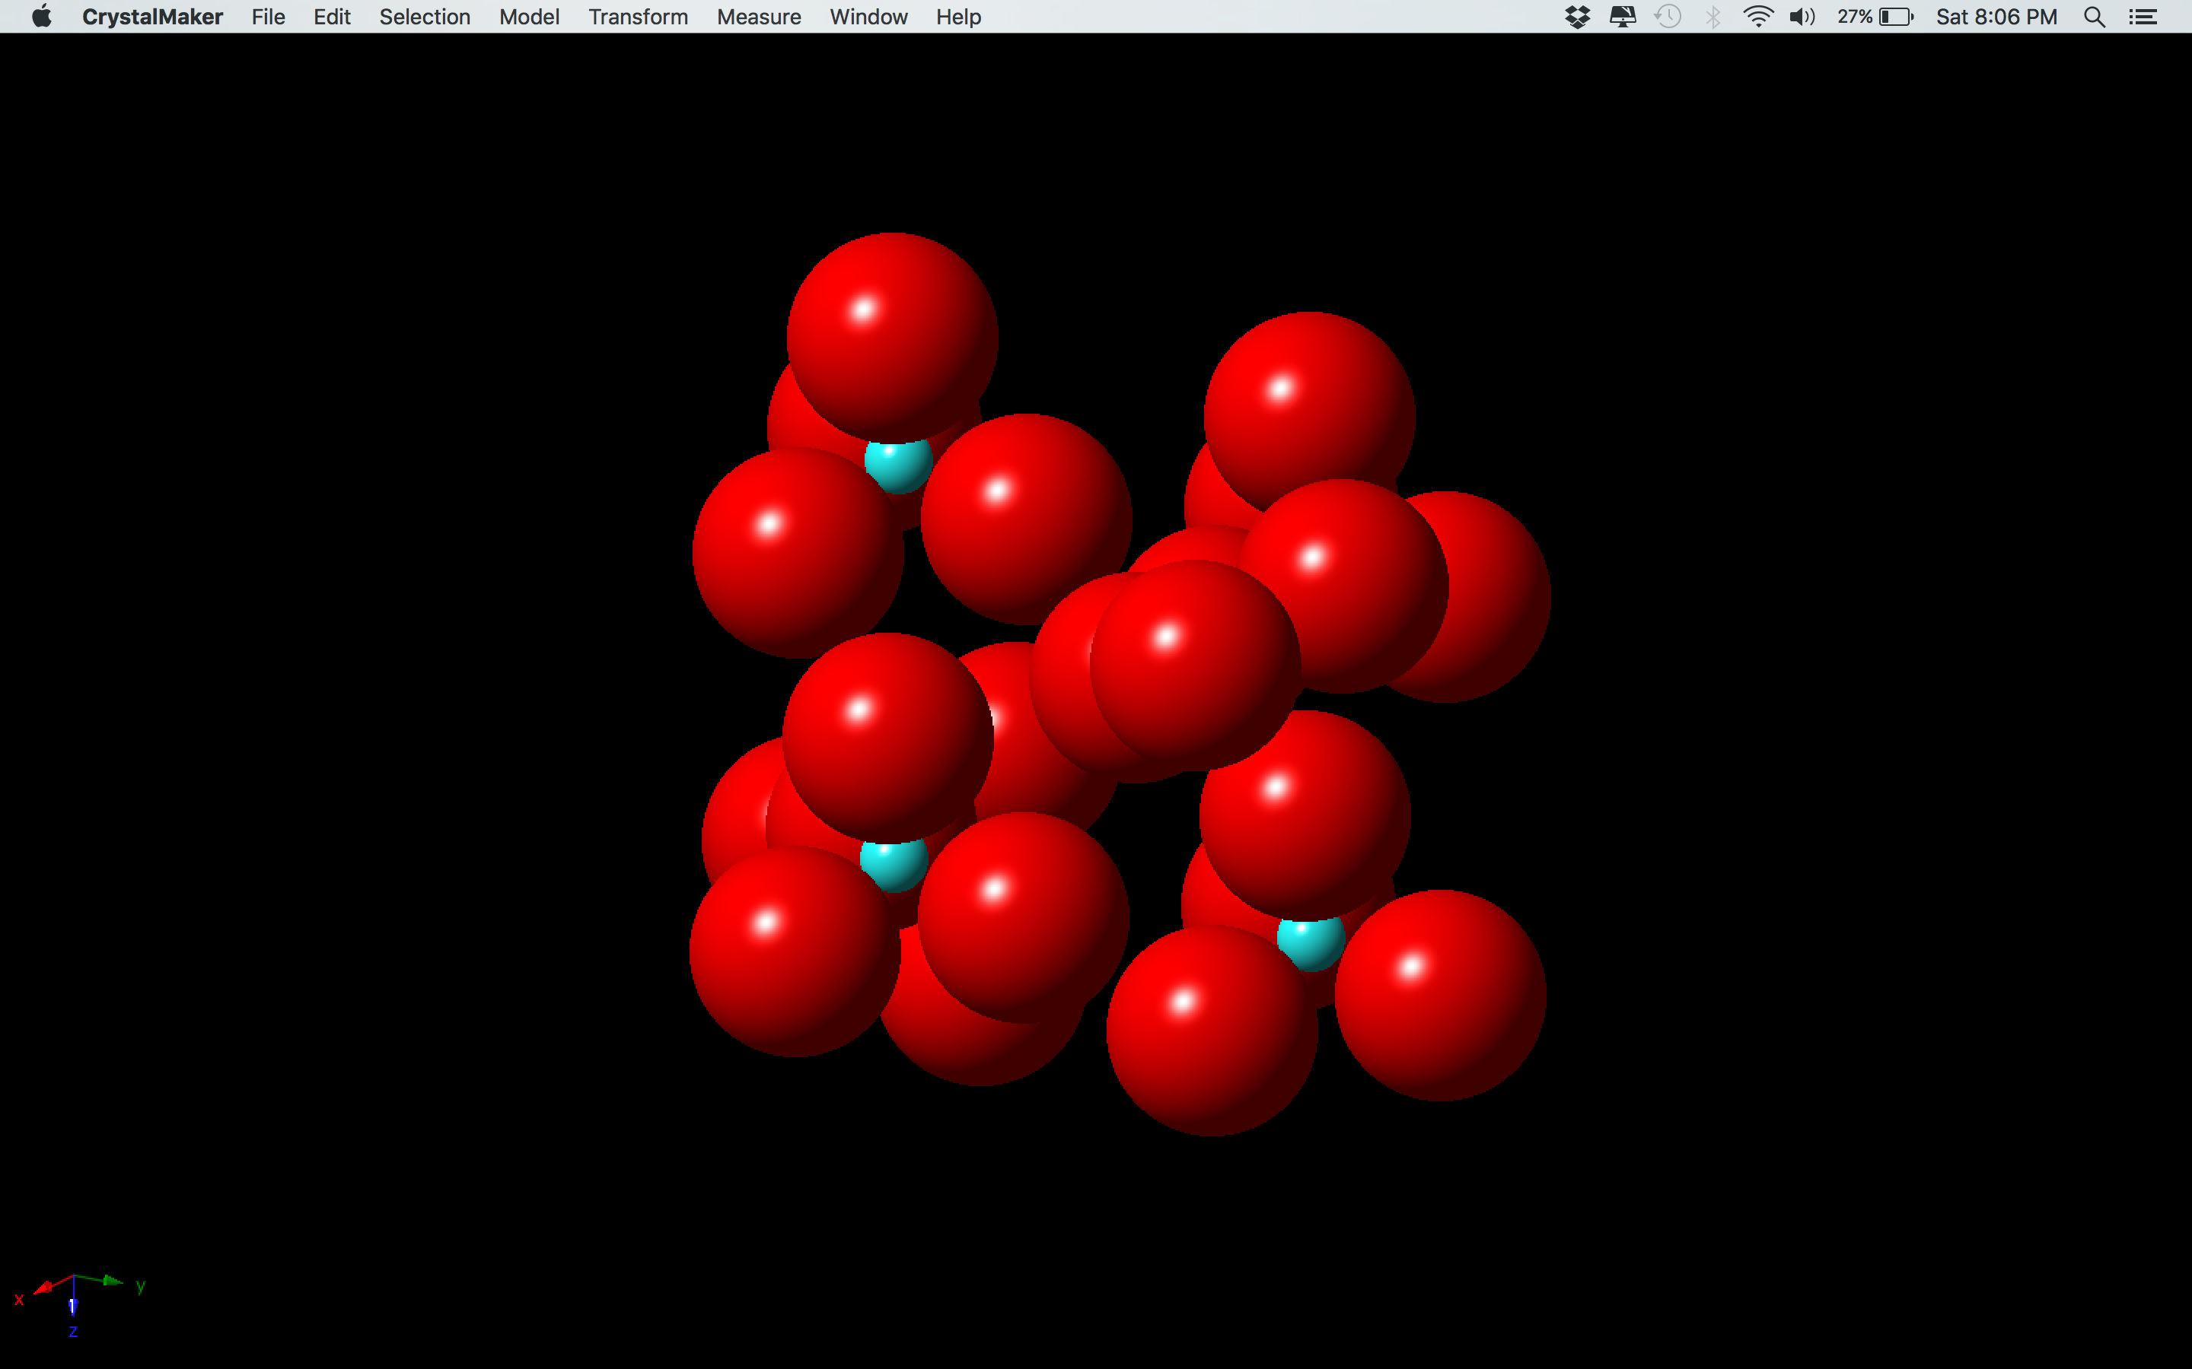
Space Filling Model
Animation Slides

Slide 5
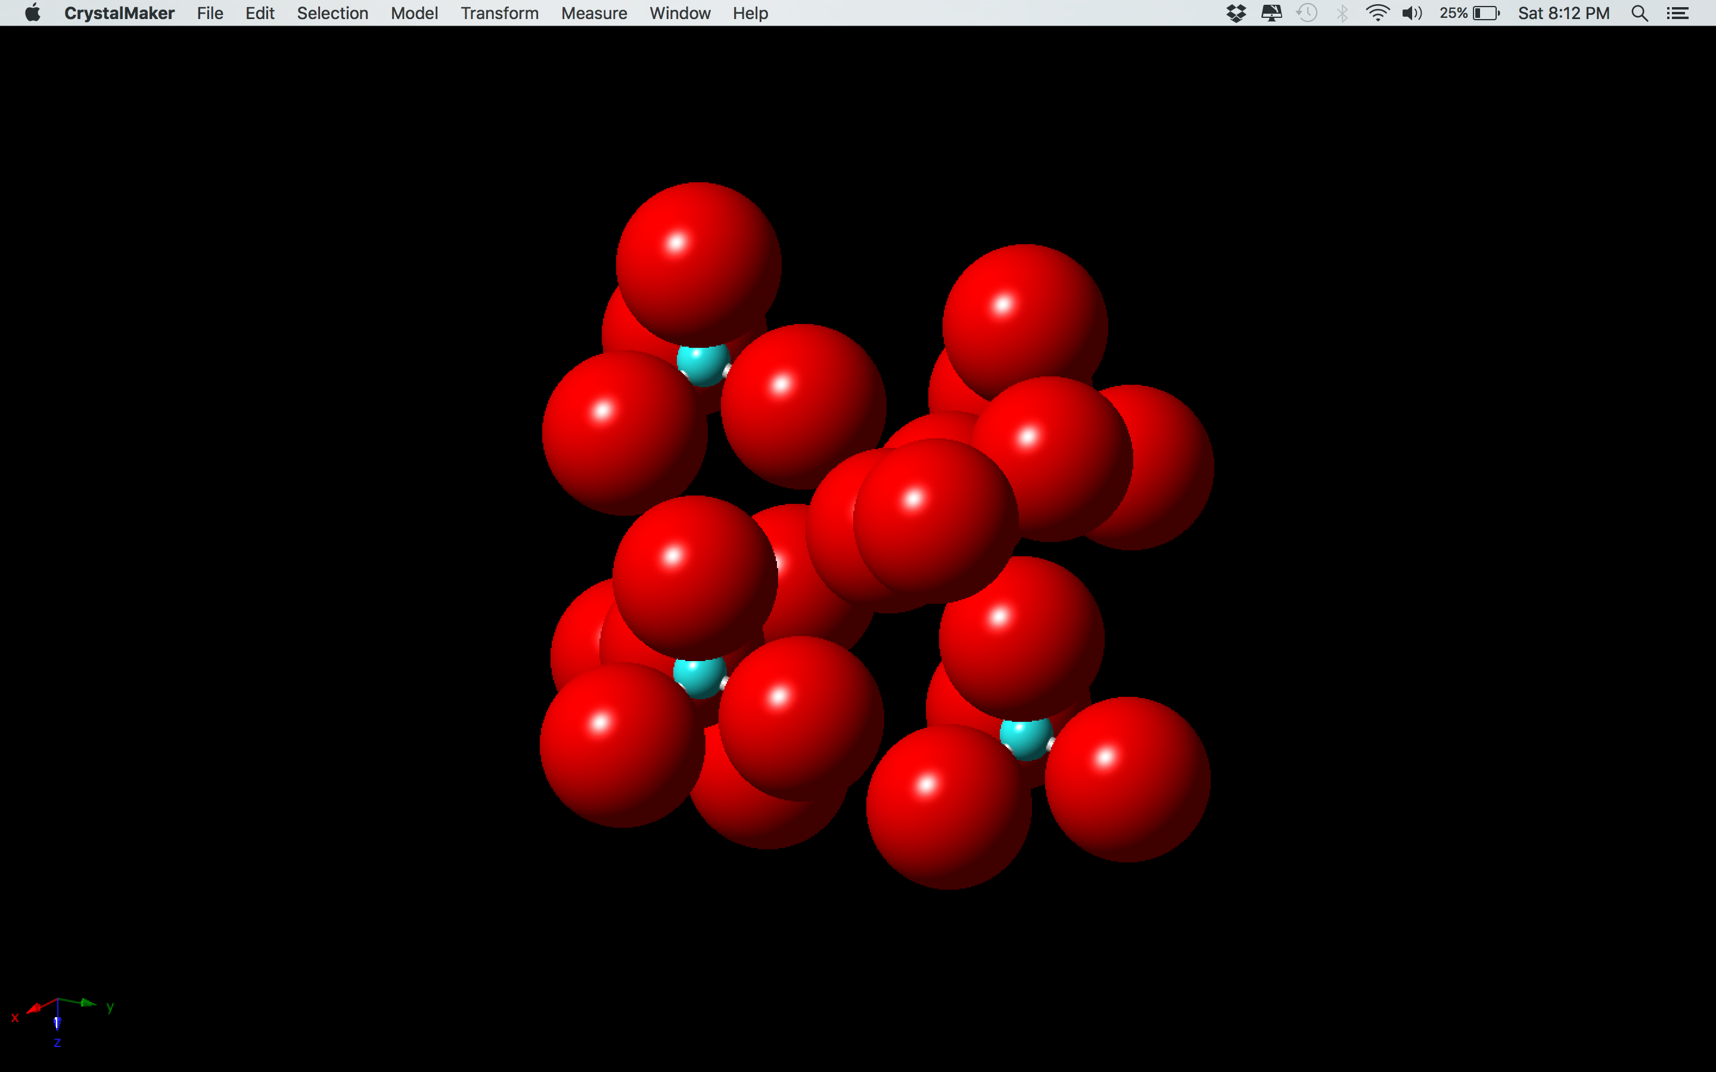
Add Bonds, Decrease Oxygen Sizes…

Slide 6
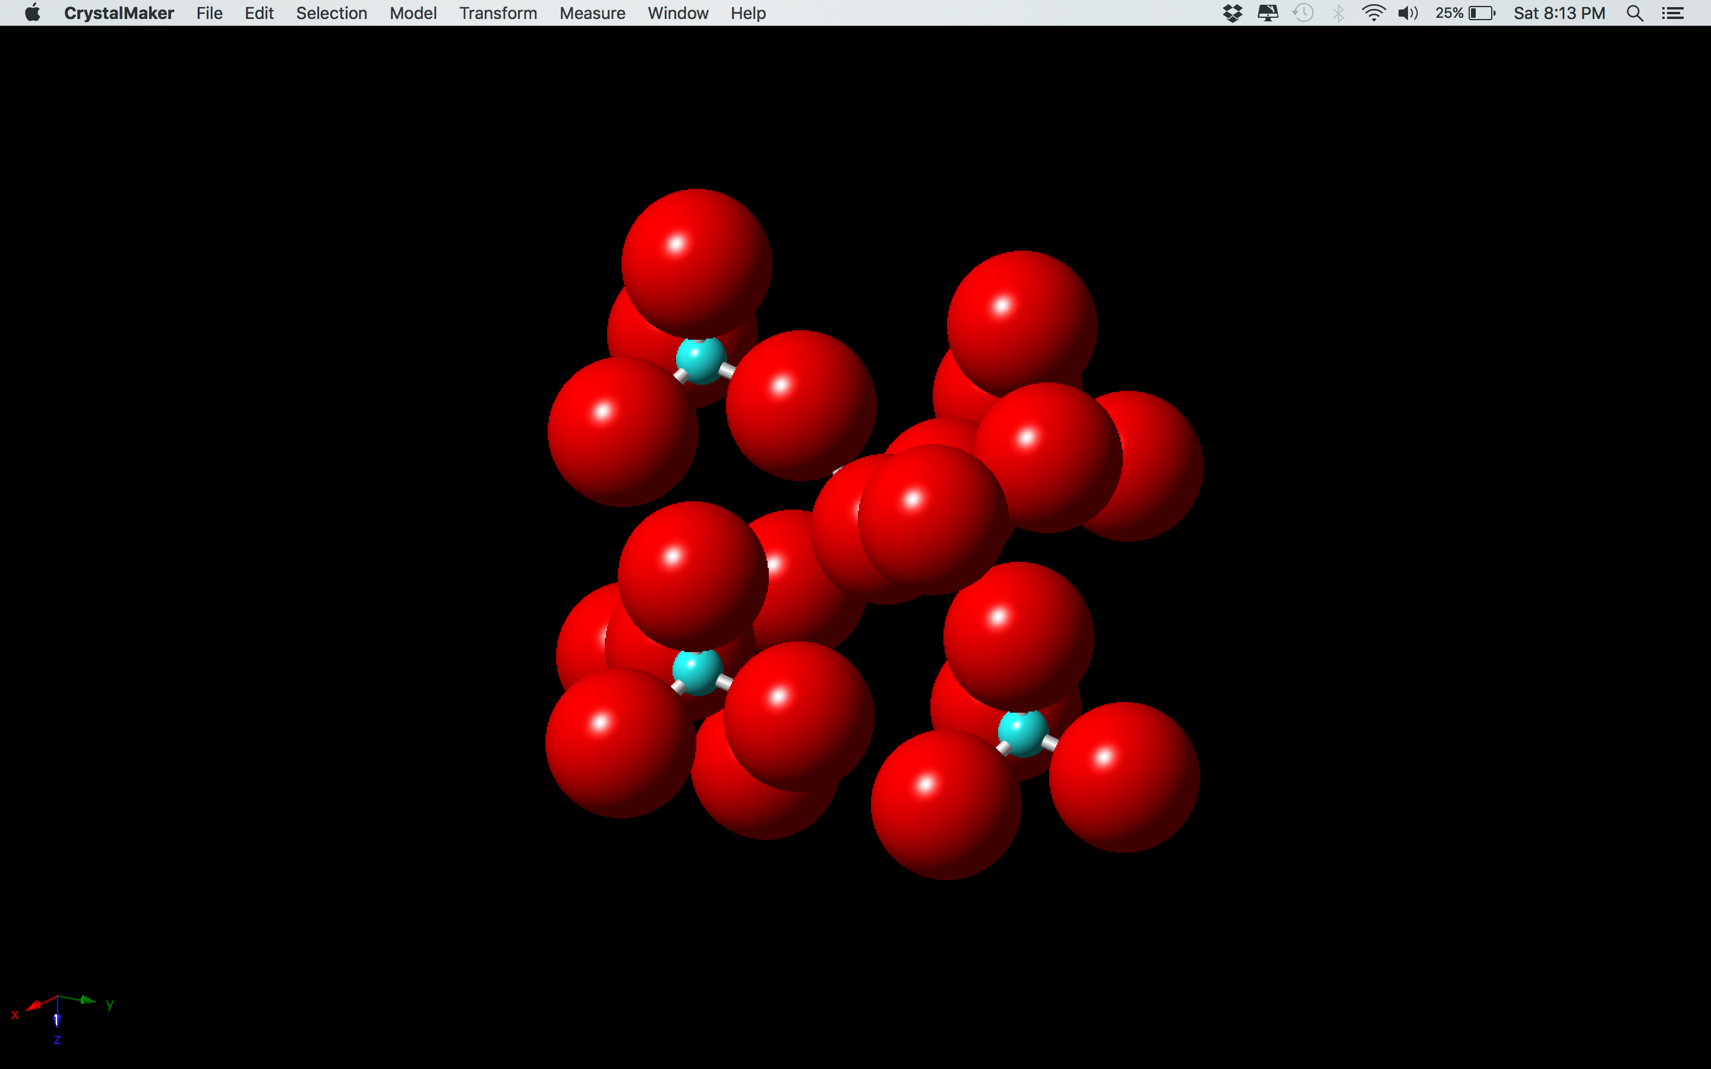

Slide 7
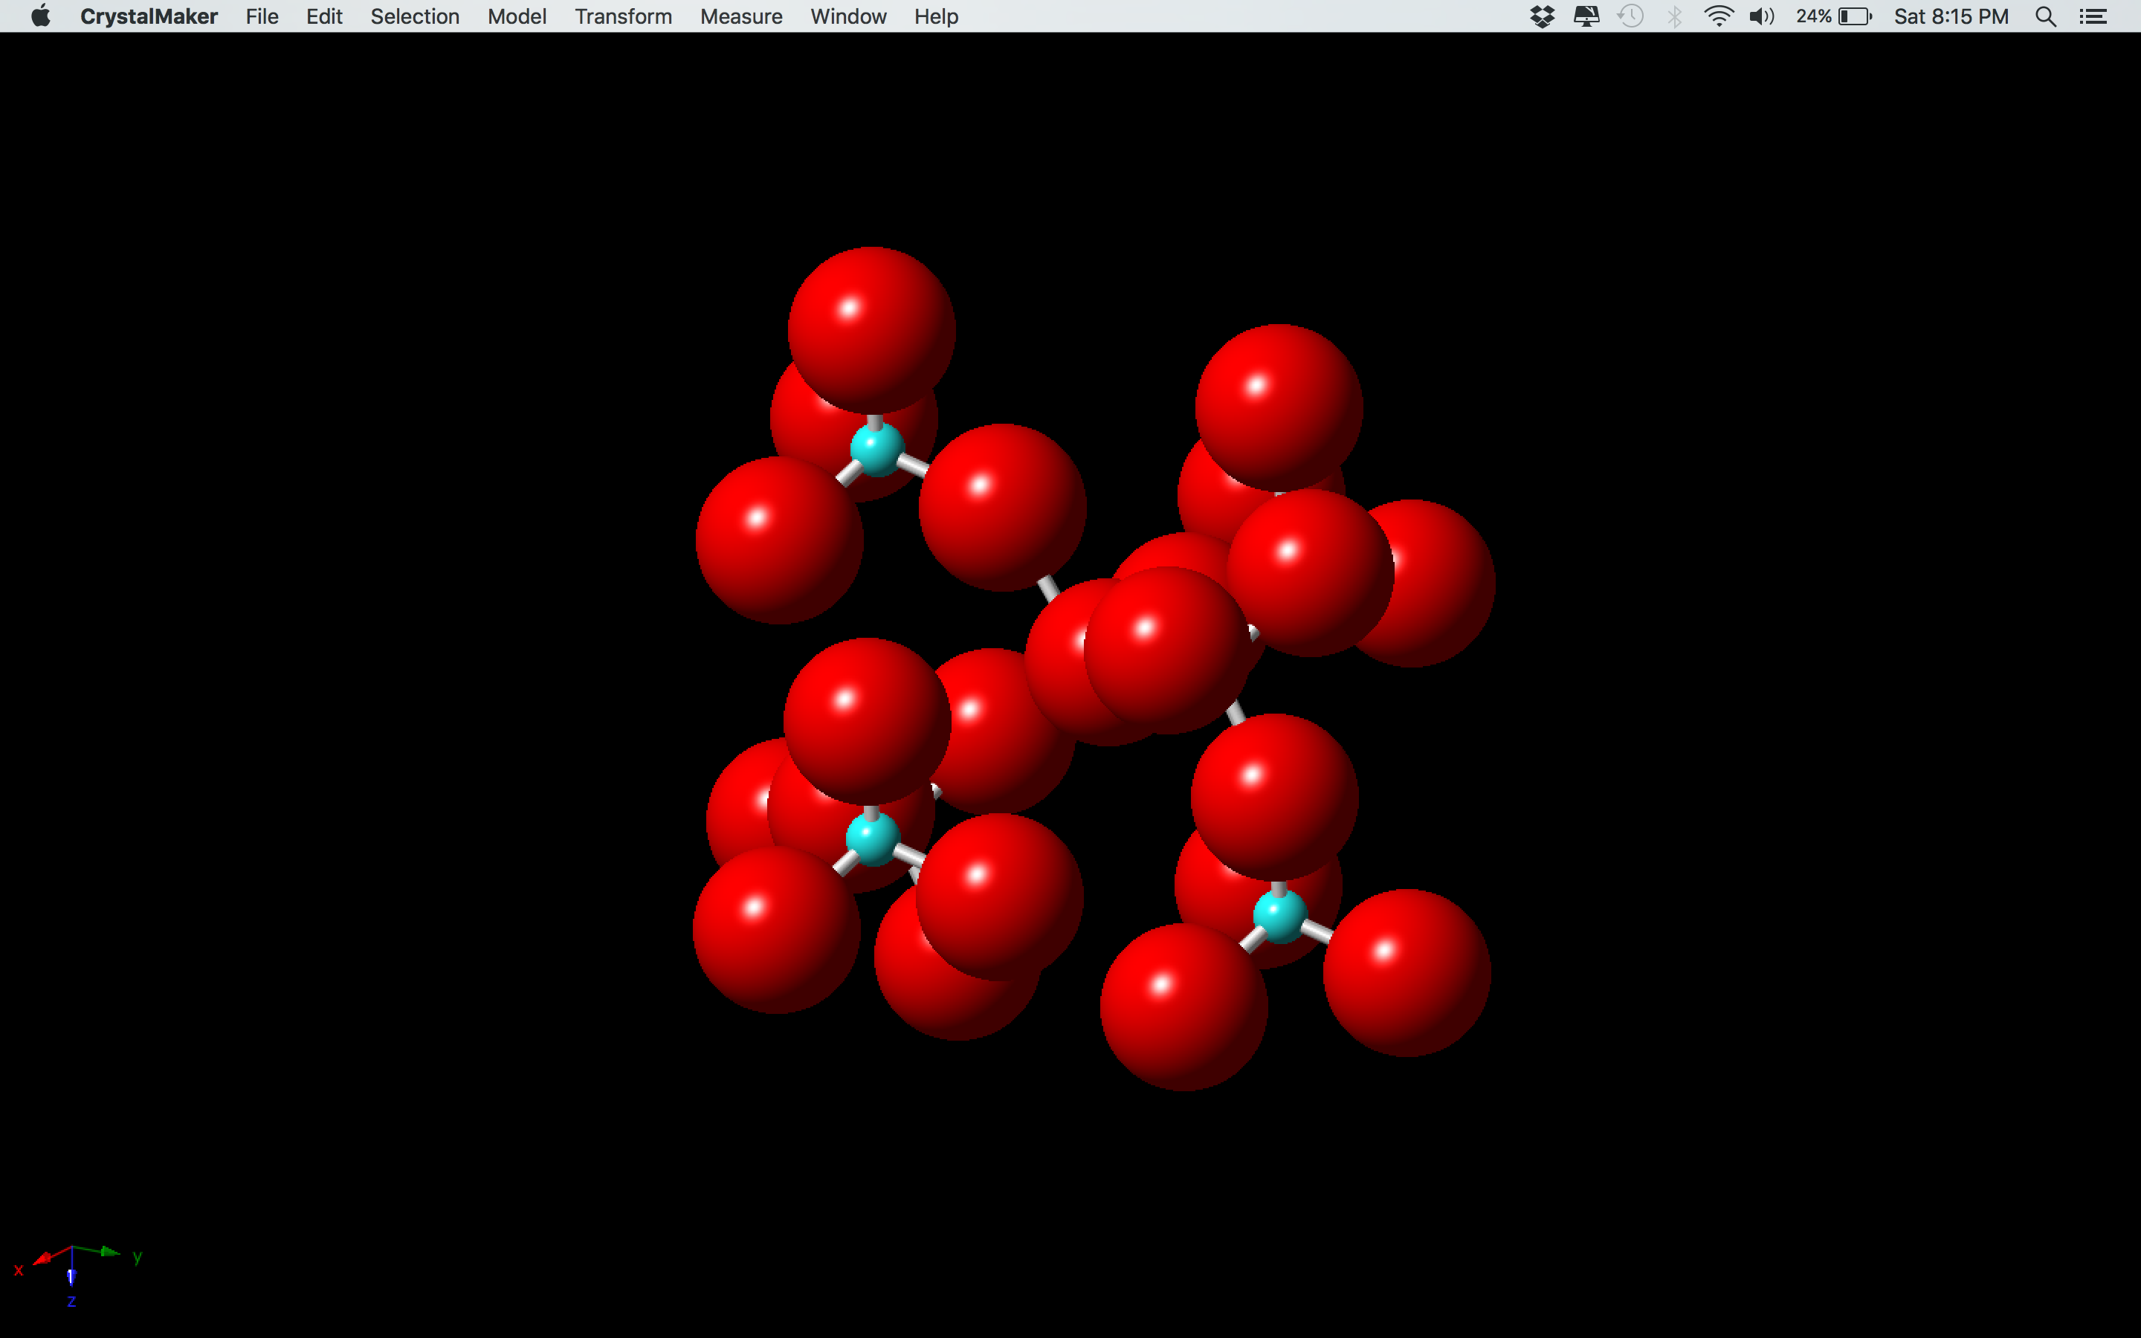

Slide 8
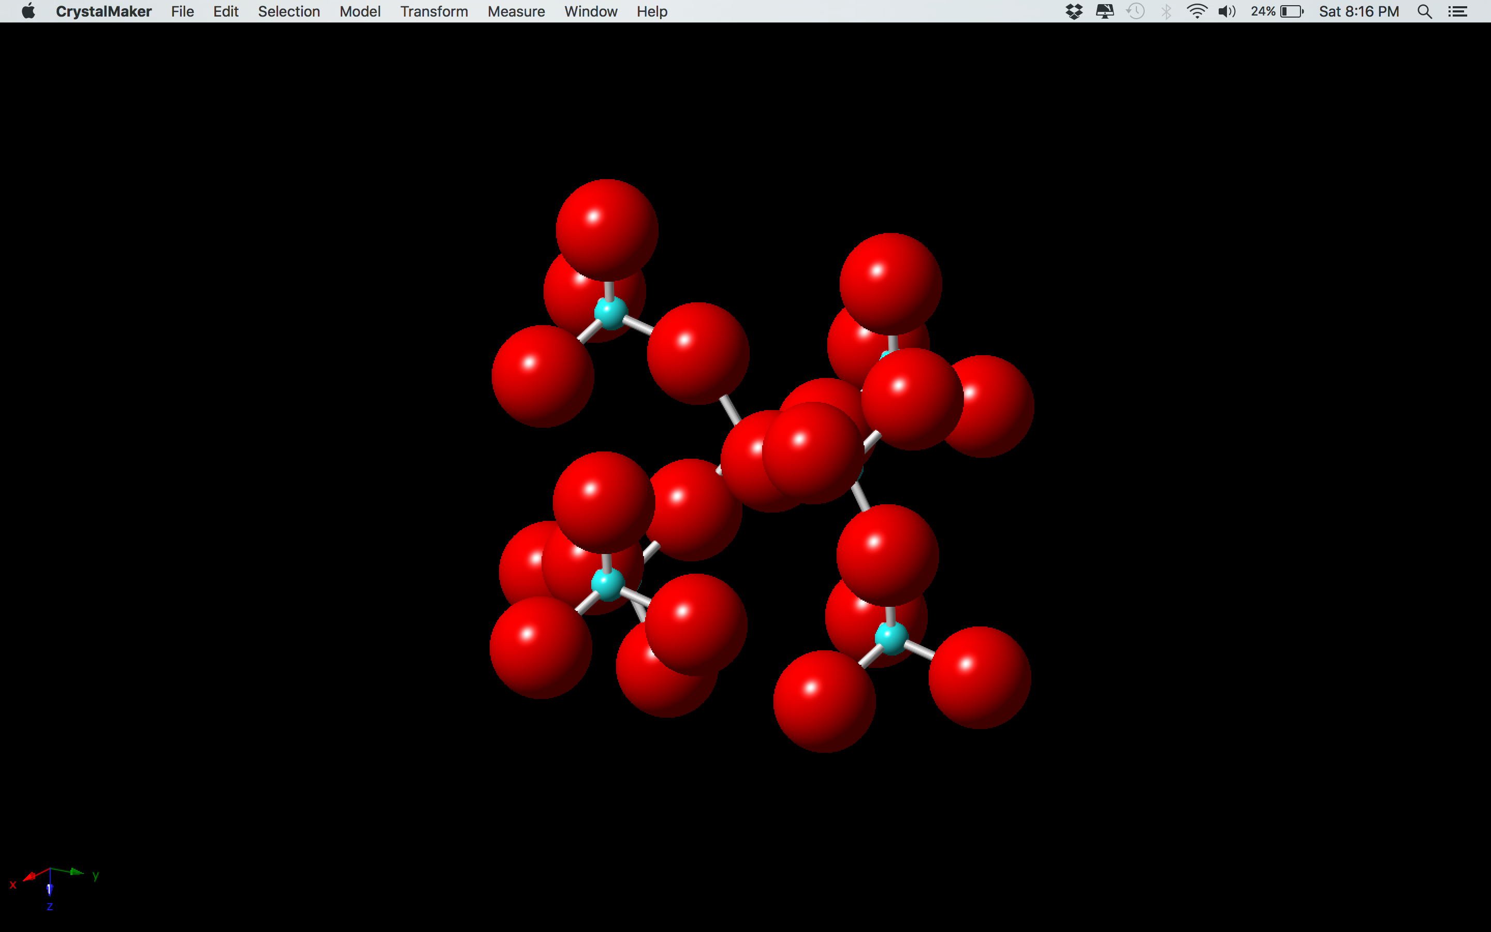

Slide 9
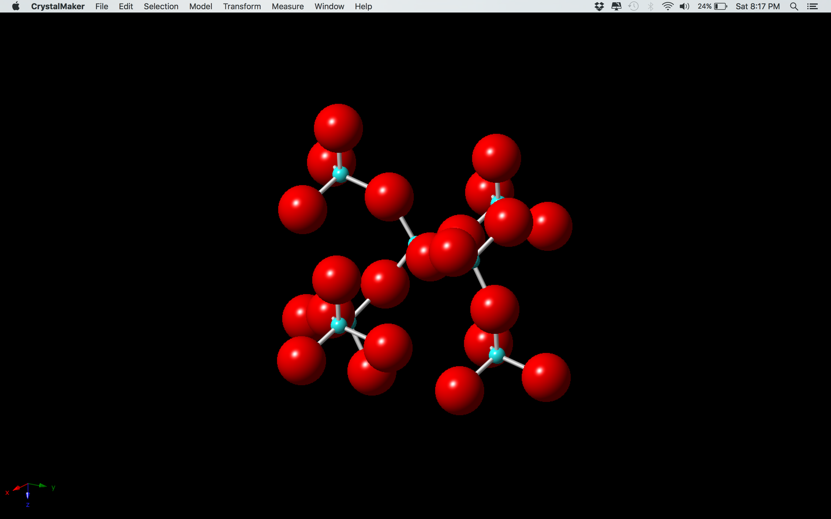

Slide 10
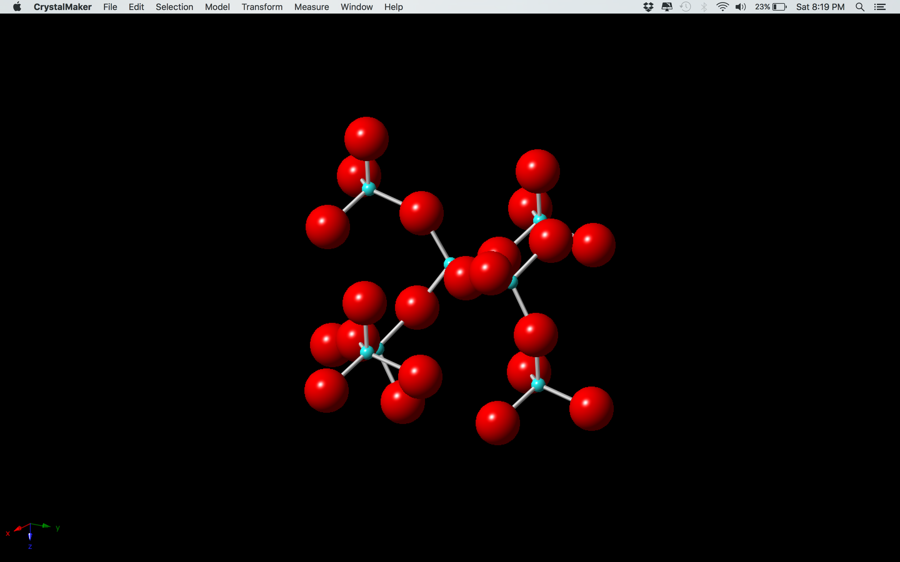

Slide 11
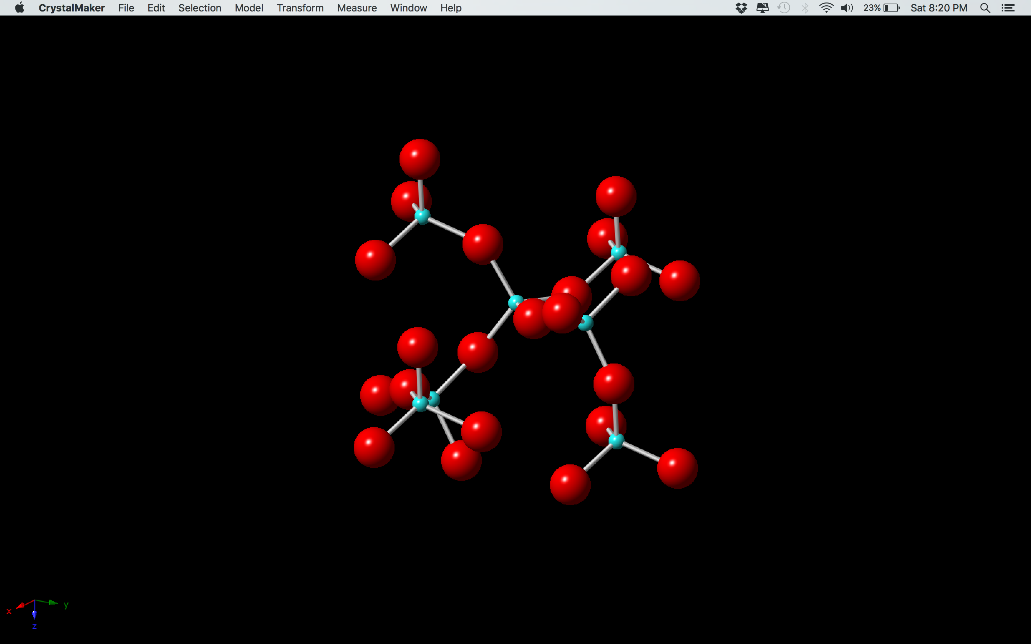
Ball and Stick Model

Slide 12
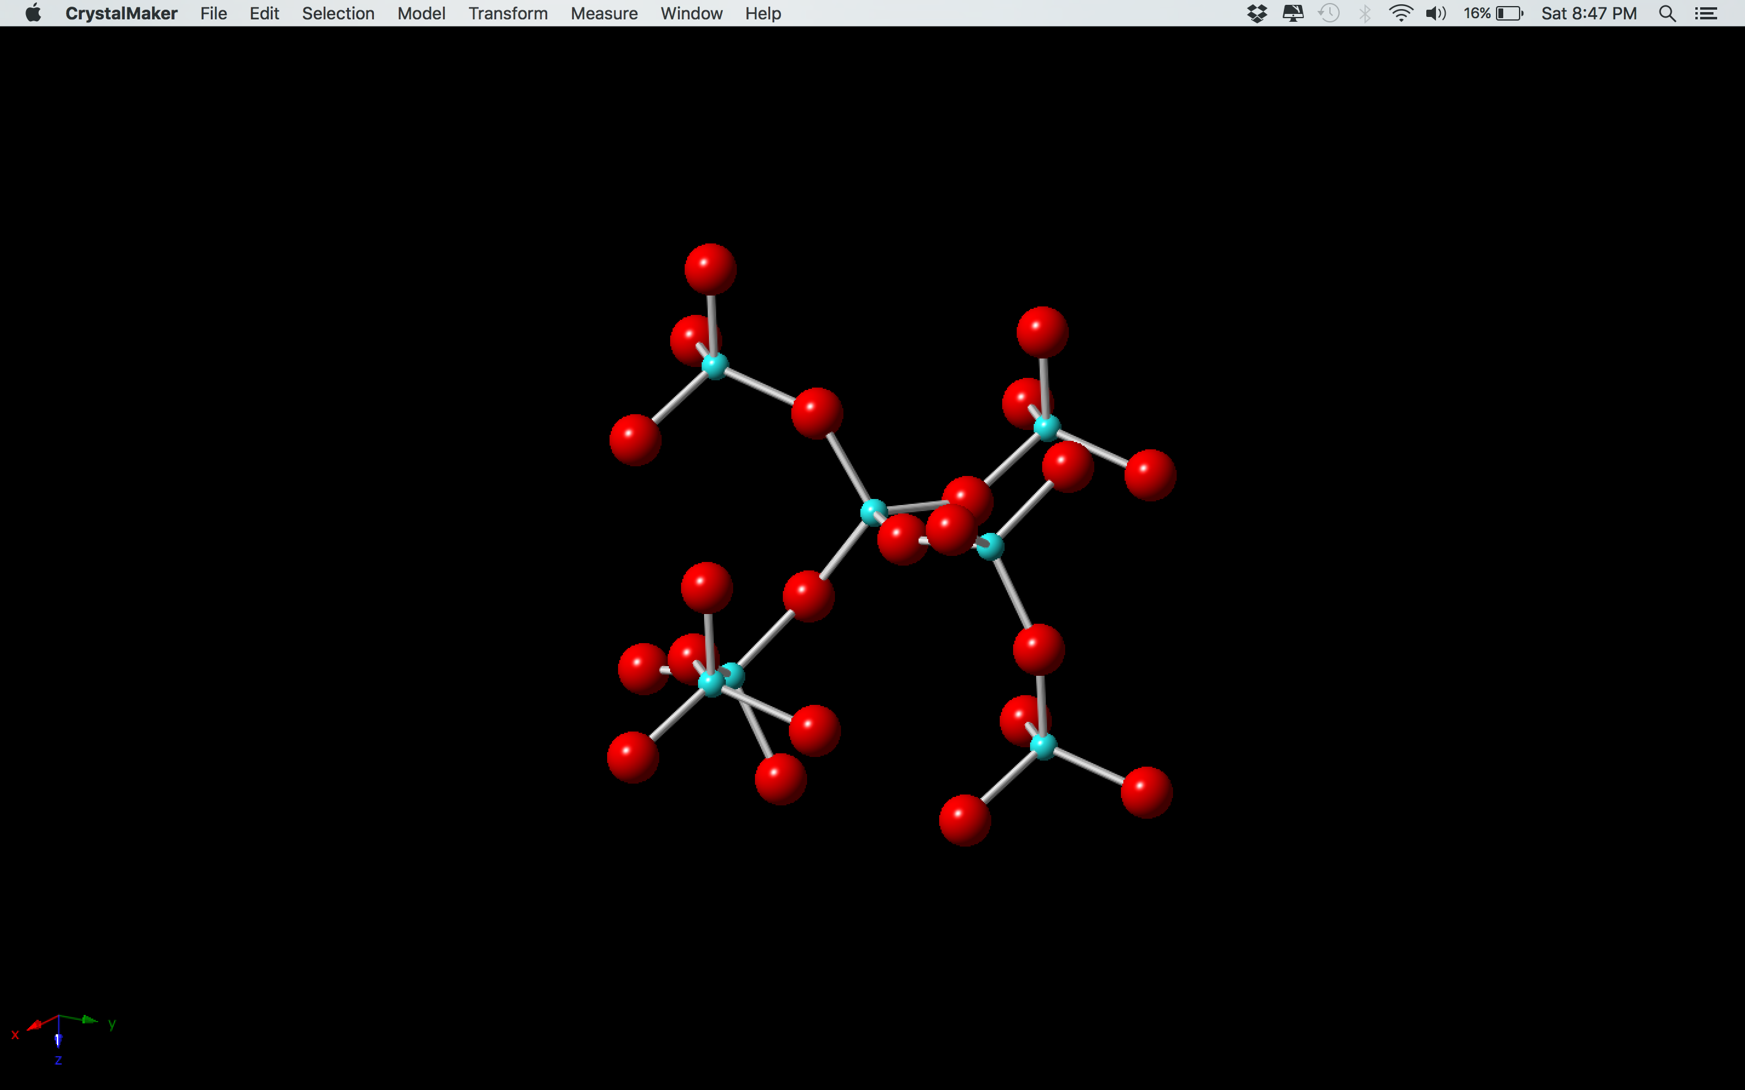

Slide 13
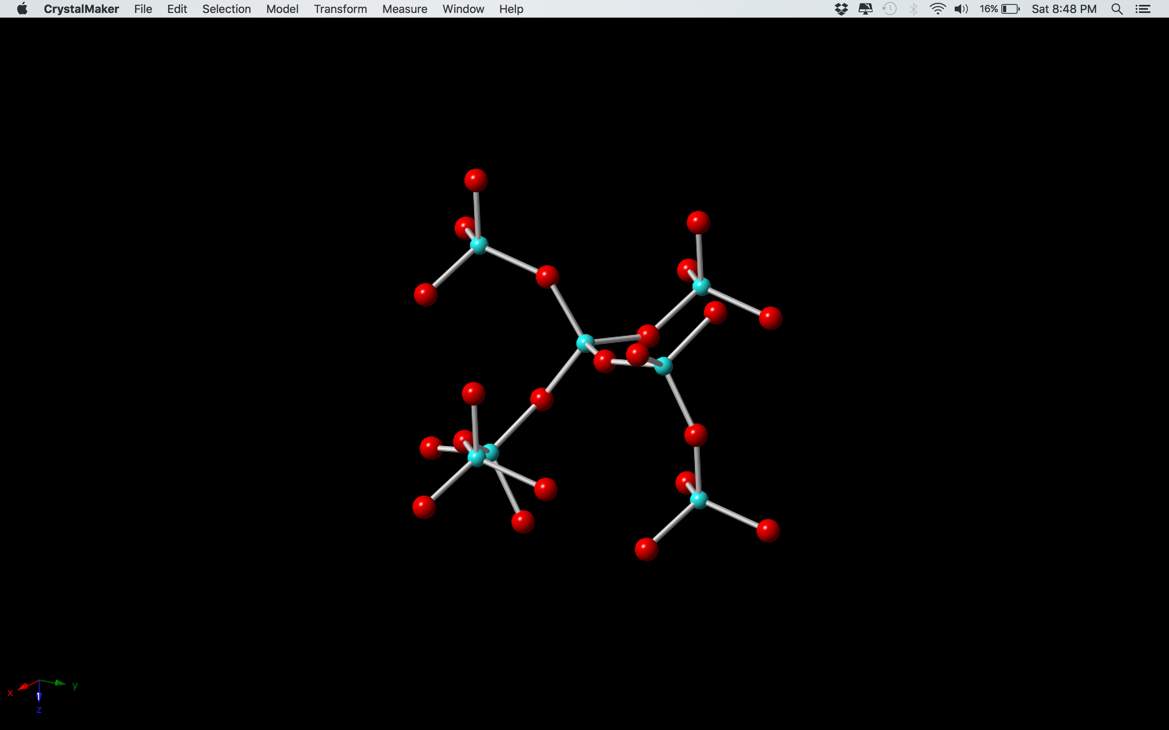

Slide 14
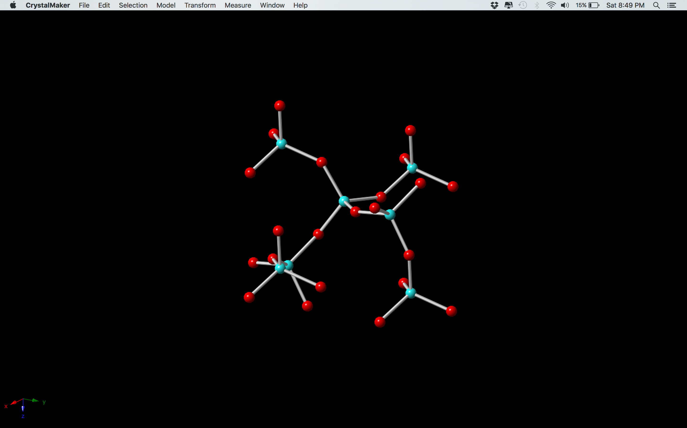

Slide 15
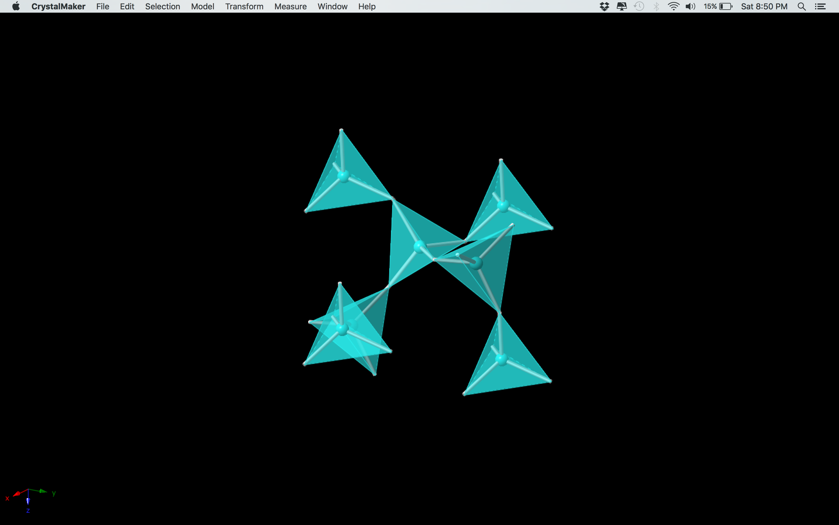

Slide 16
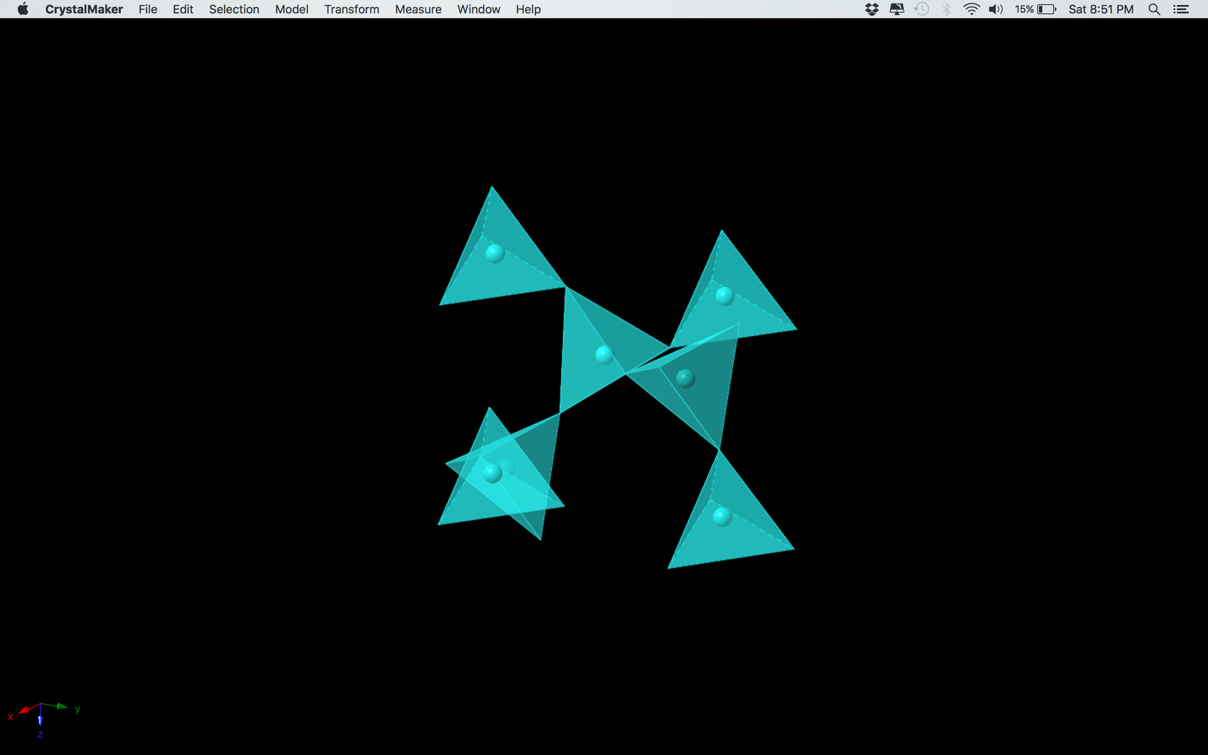

Slide 17


Slide 18
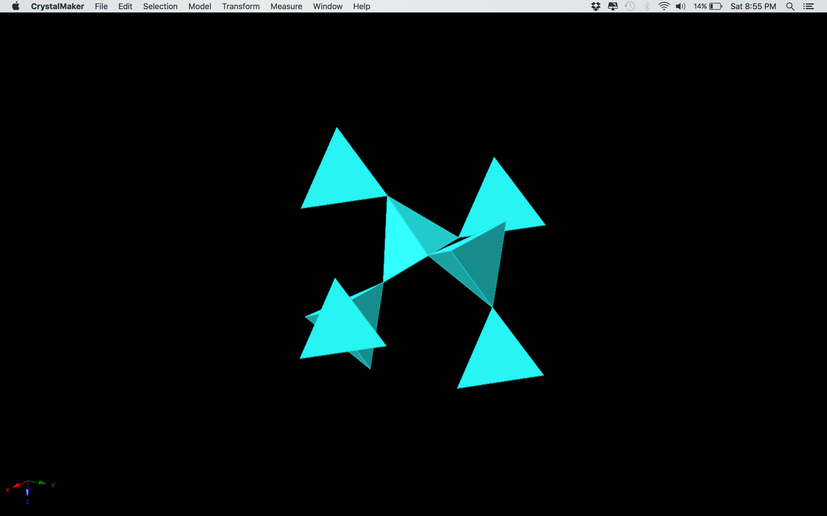
Polyhedral Model

Slide 19
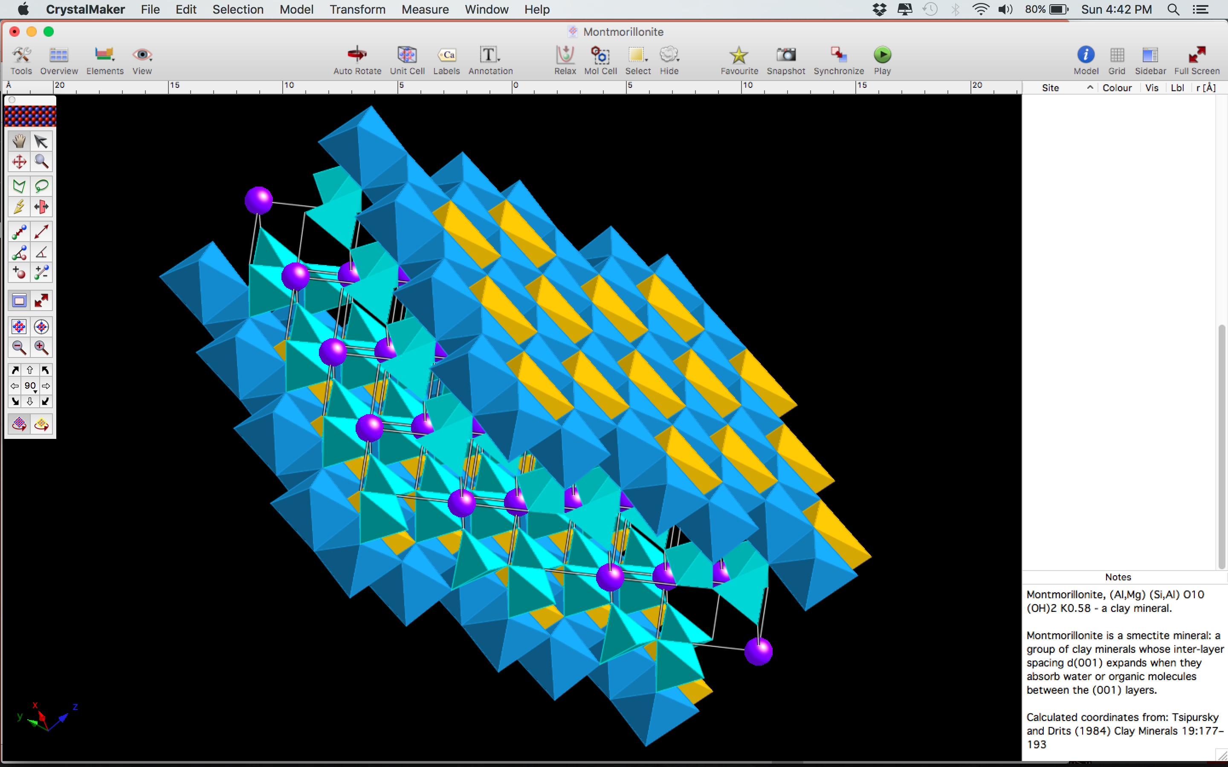
We Can Show Other Concepts Too
Let’s look at the density of quartz along different axes of the unit cell.

Slide 20
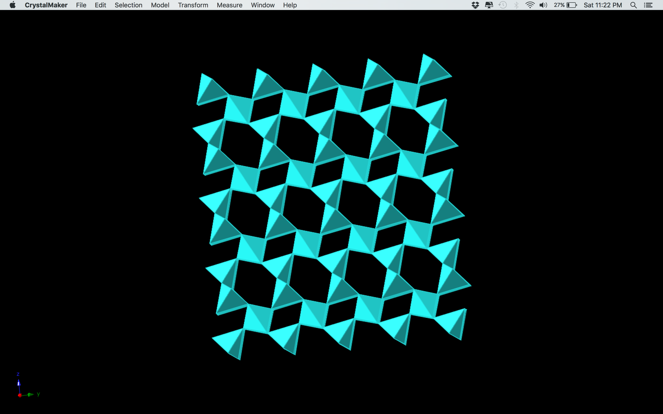
Looking Along X-Axis

Slide 21
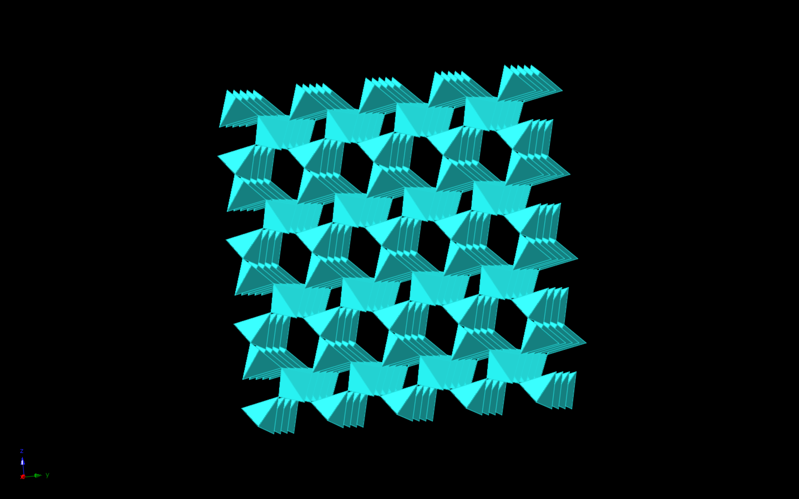

Slide 22
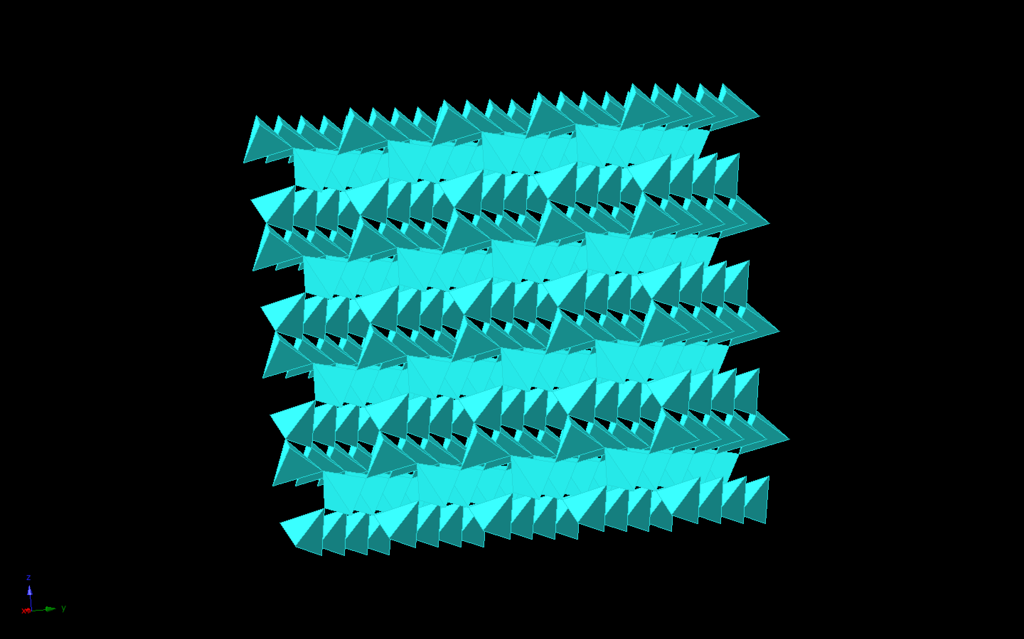

Slide 23
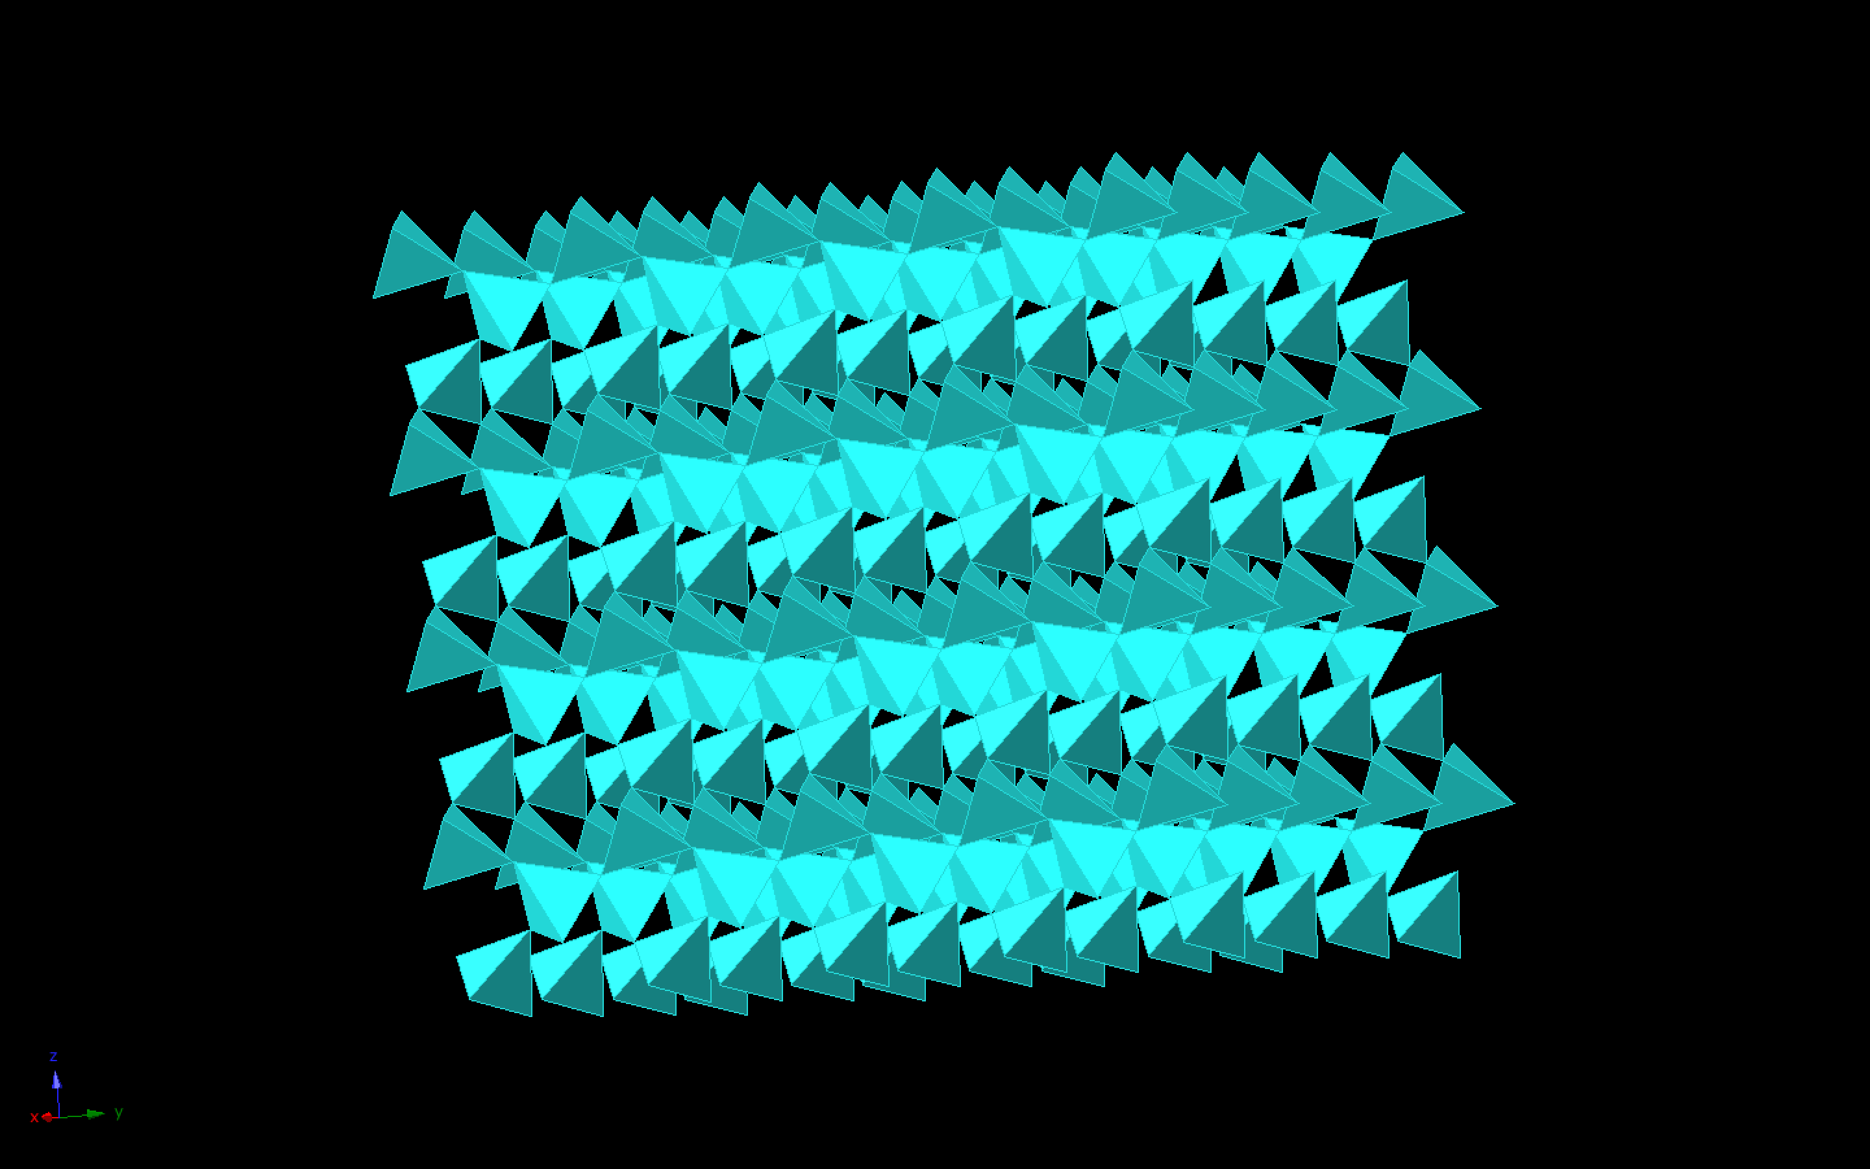

Slide 24
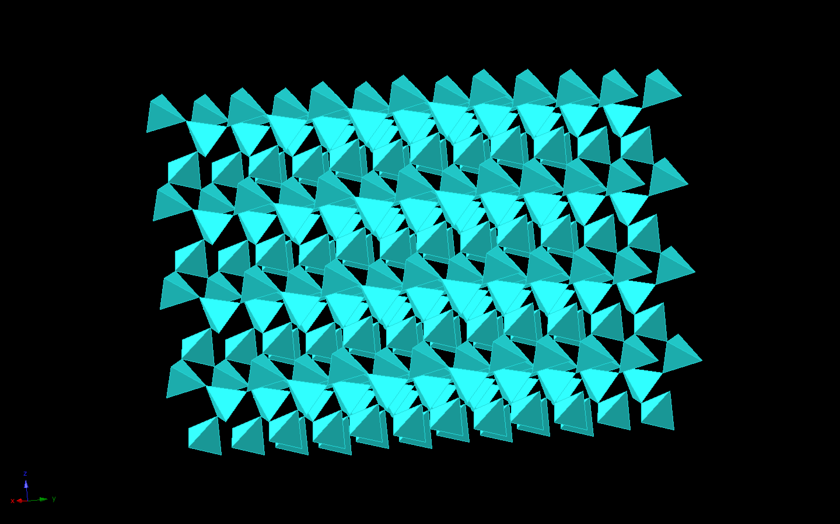

Slide 25
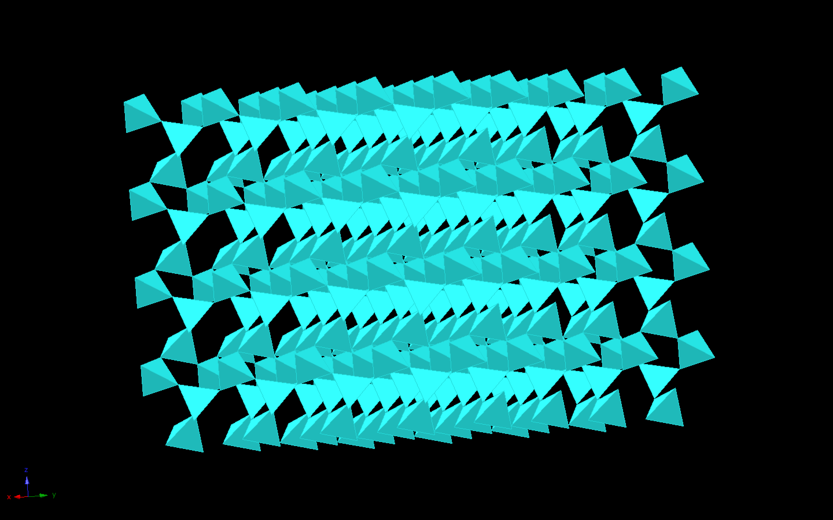

Slide 26
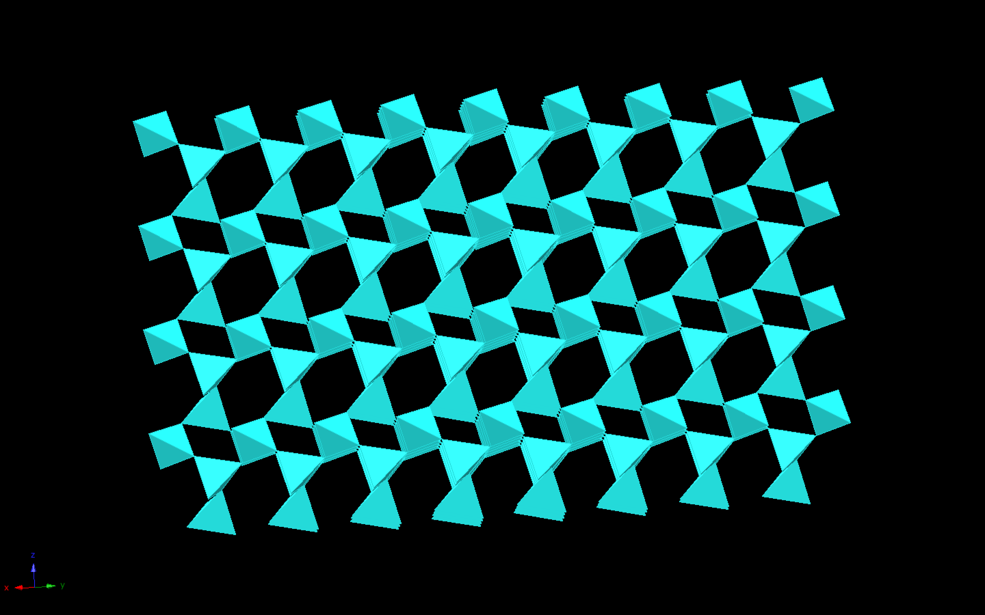

Slide 27
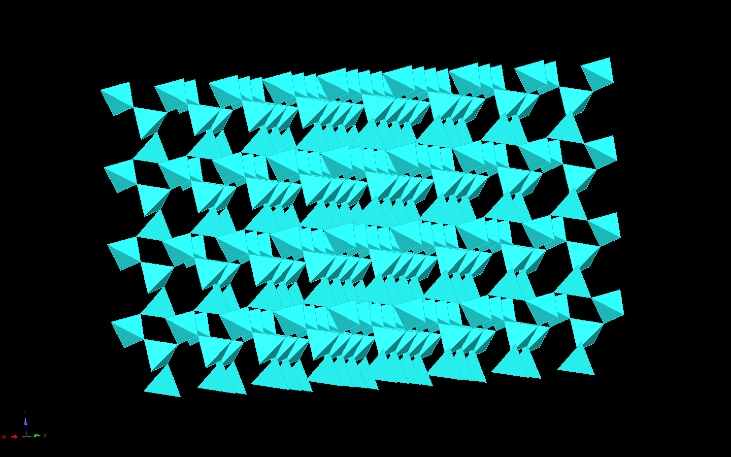

Slide 28
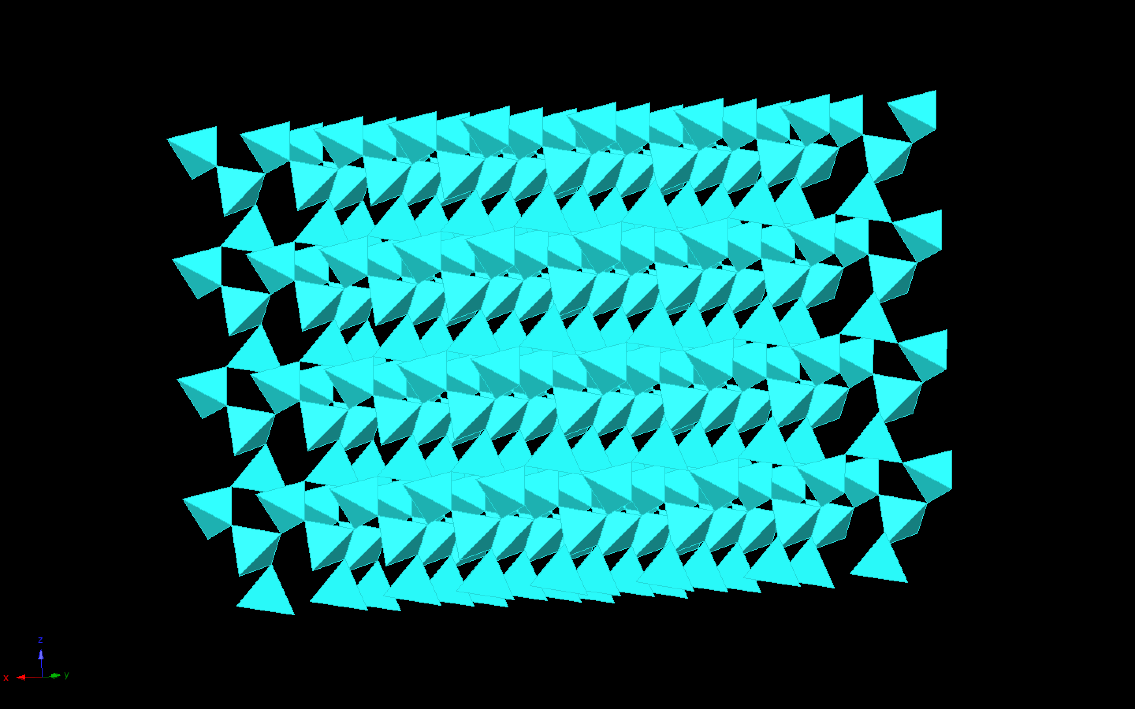

Slide 29
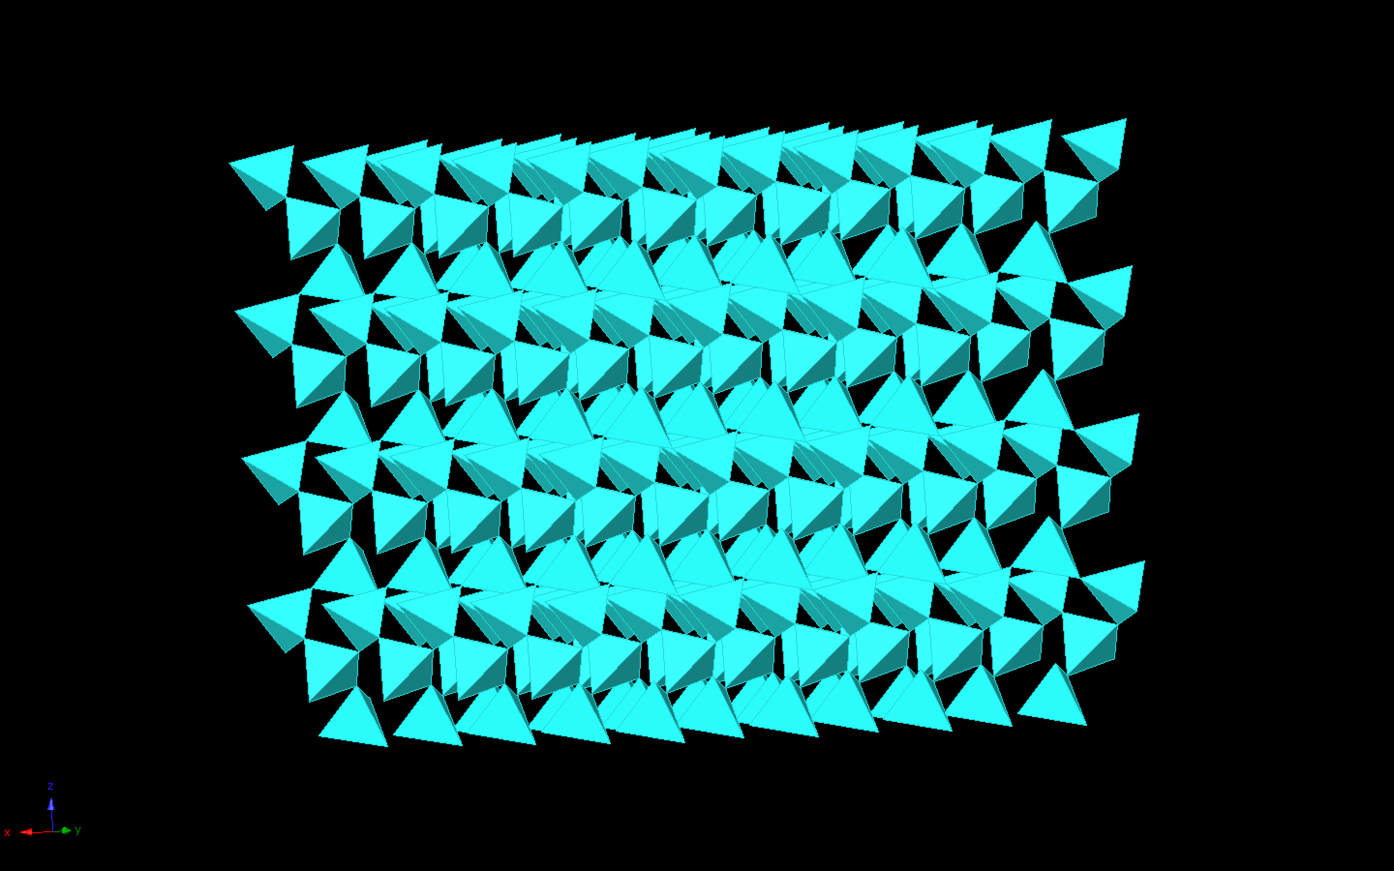

Slide 30
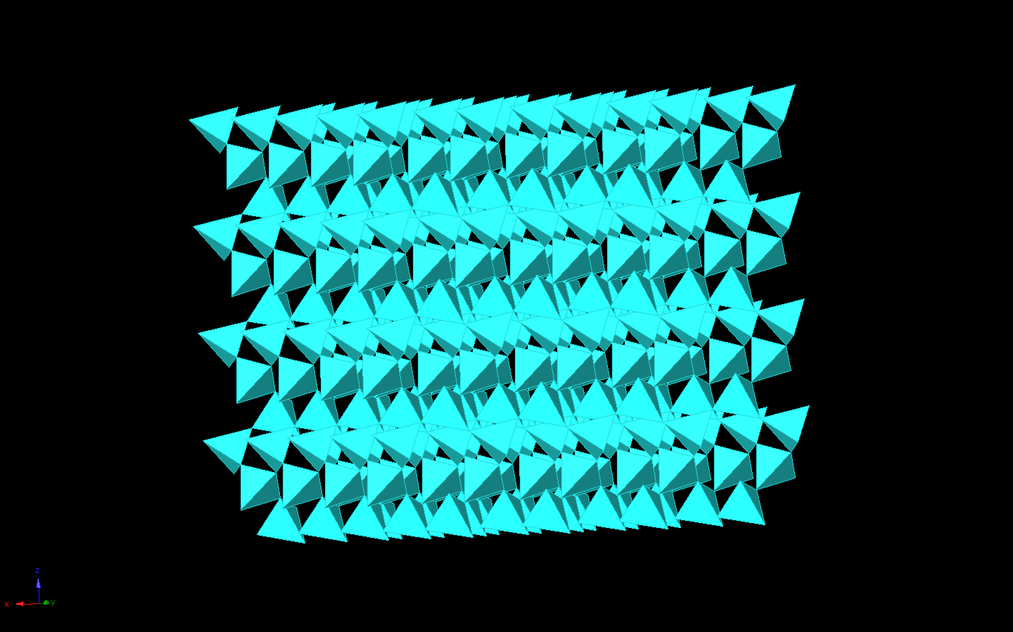

Slide 31
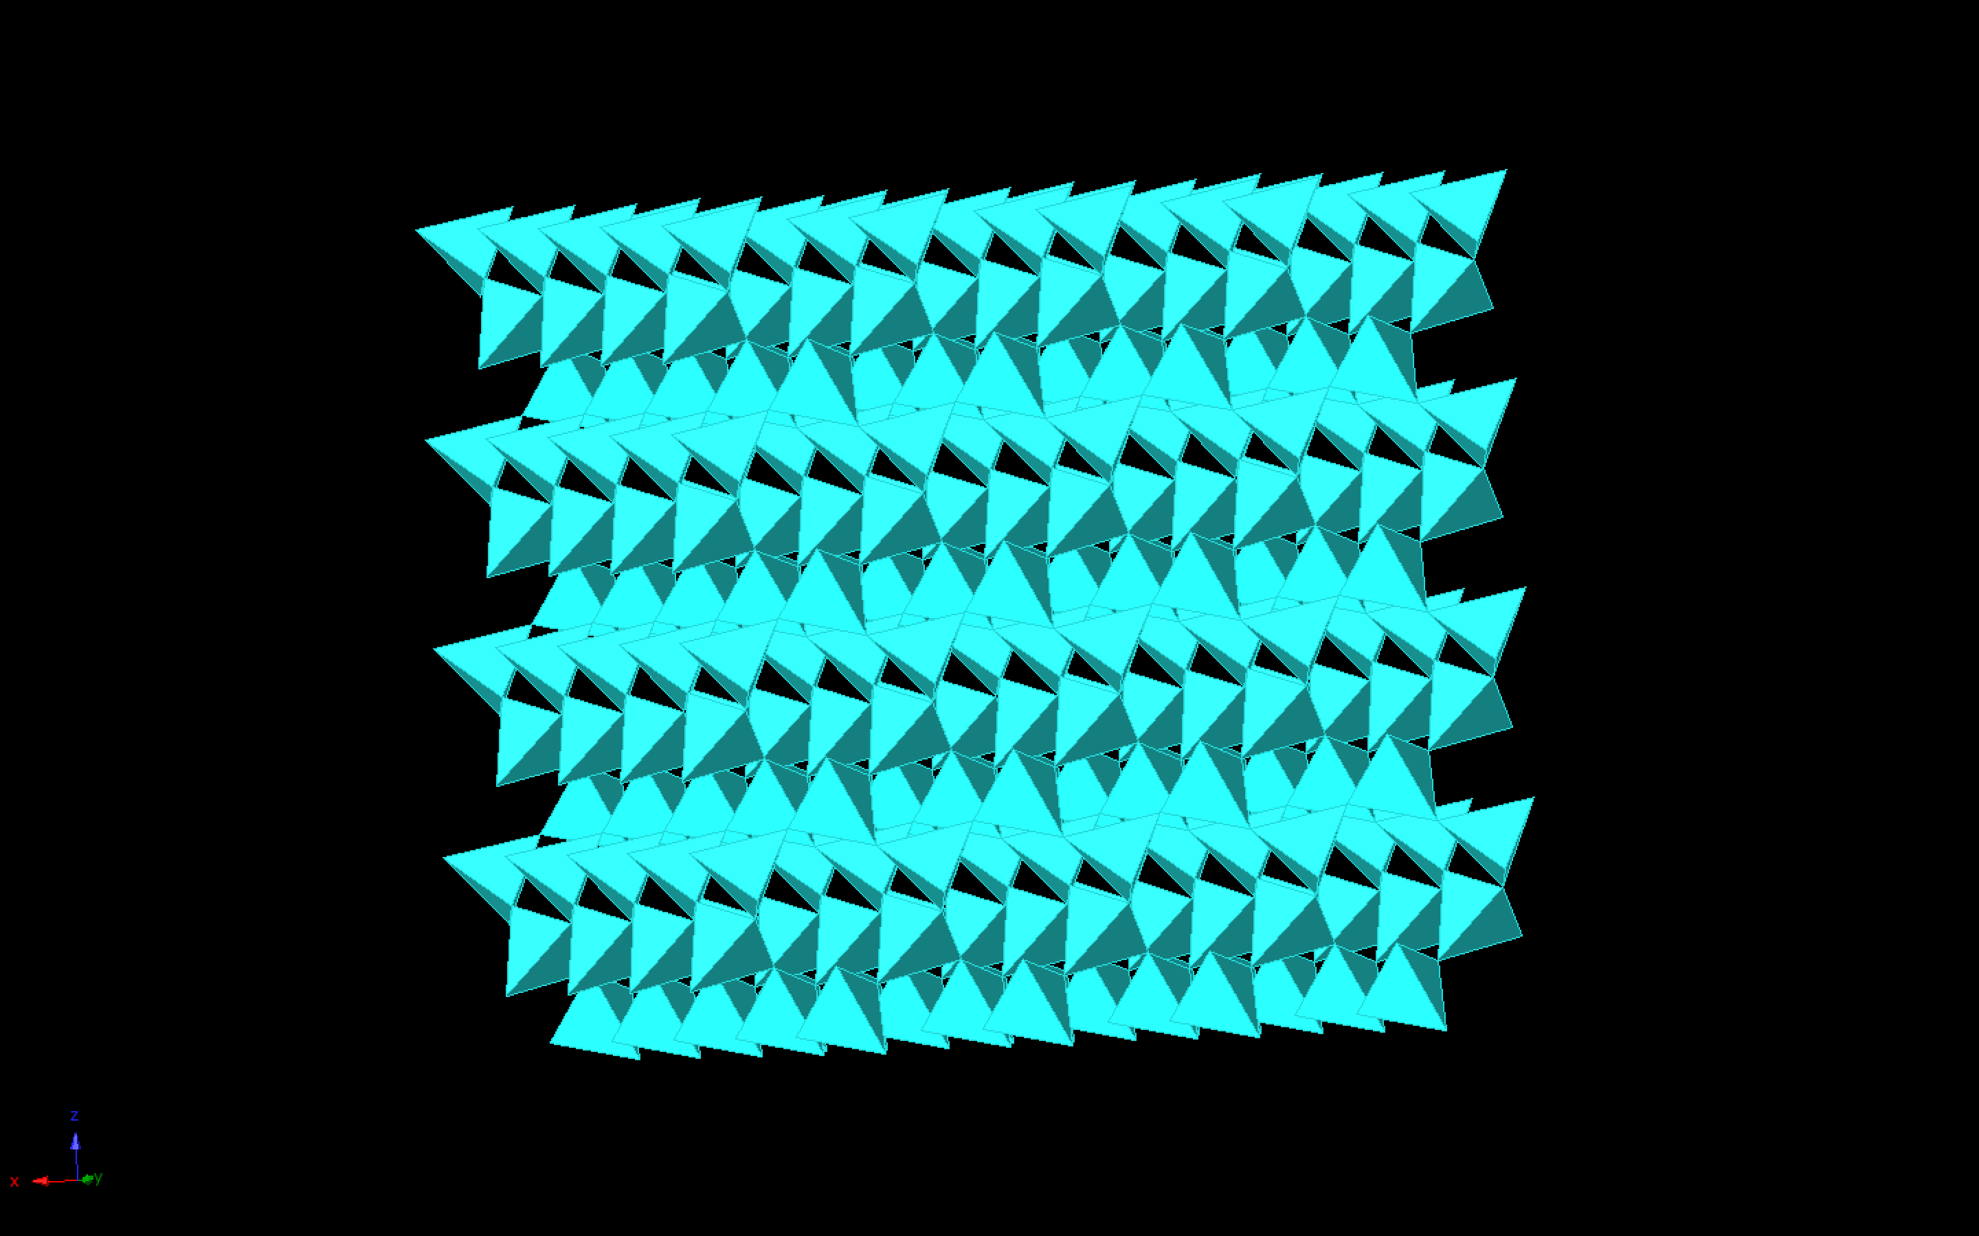

Slide 32
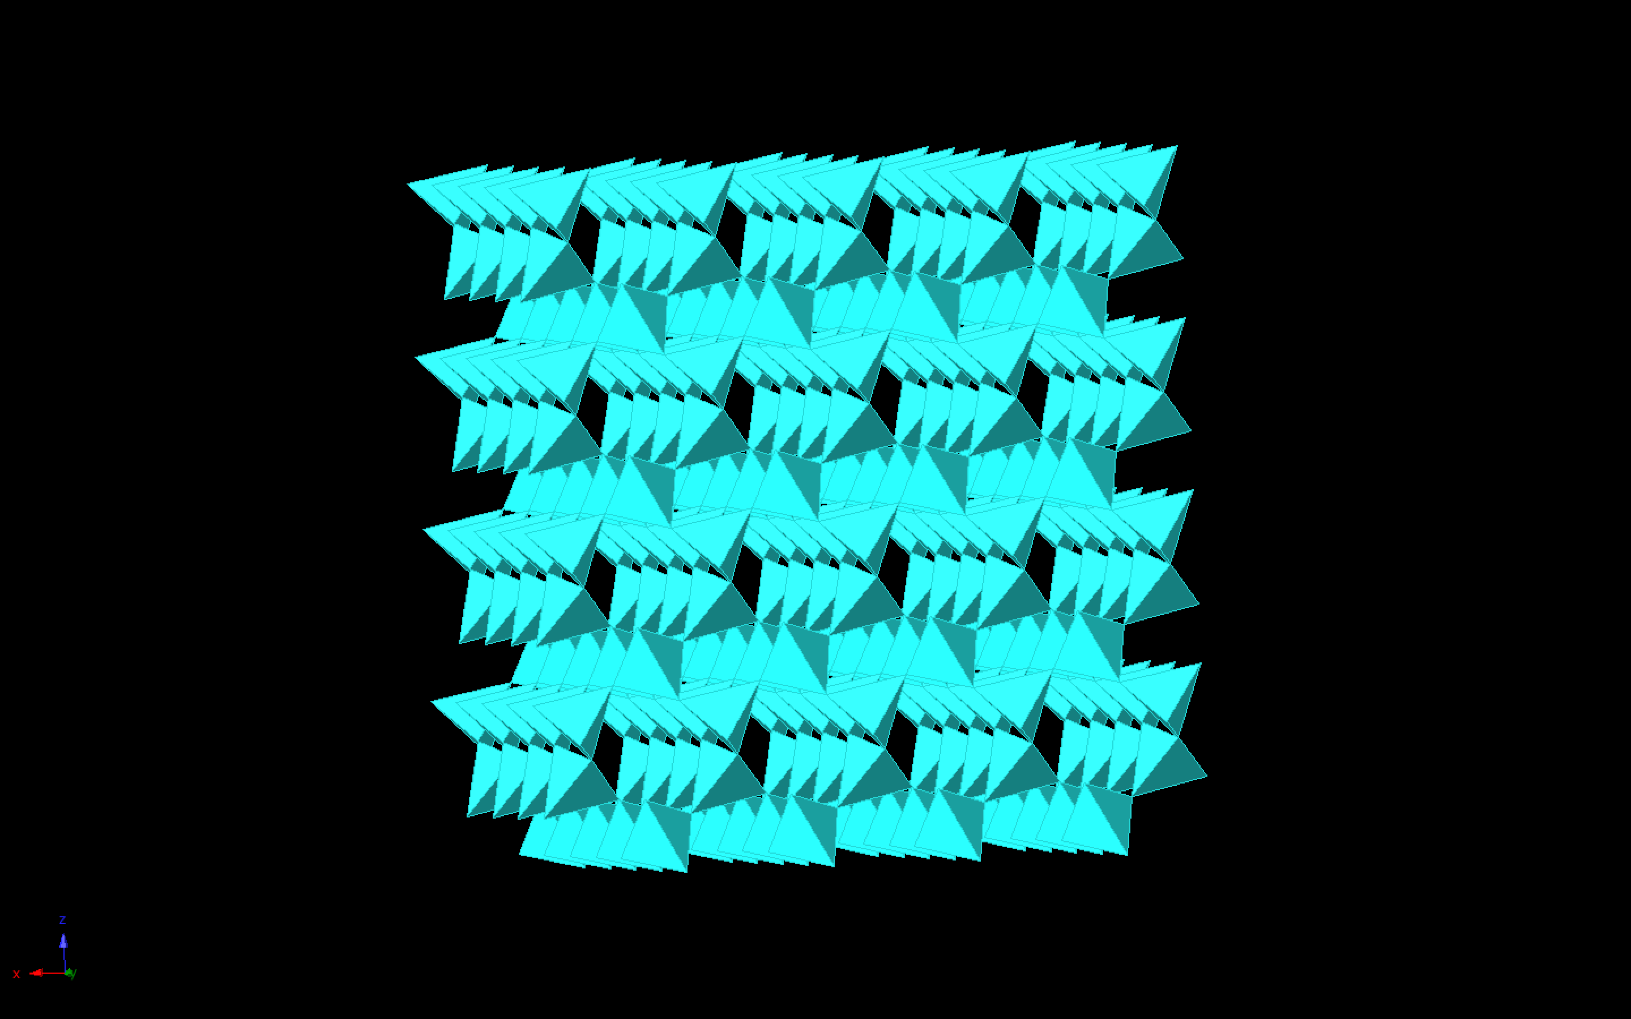

Slide 33
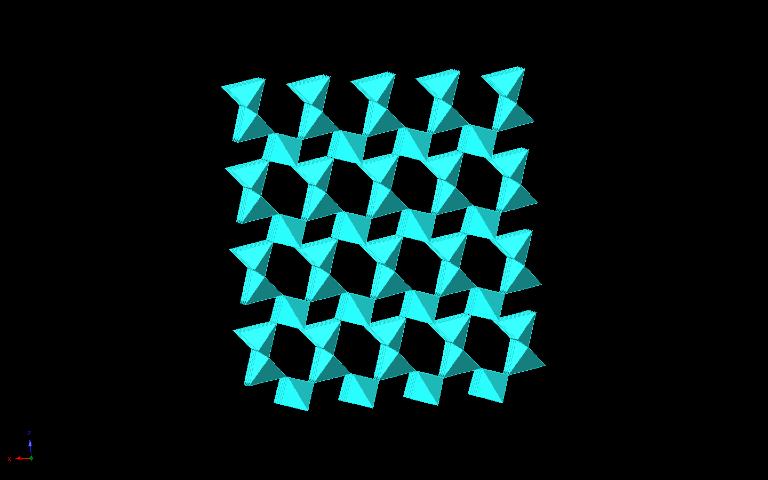
Looking Along Y-Axis

Slide 34
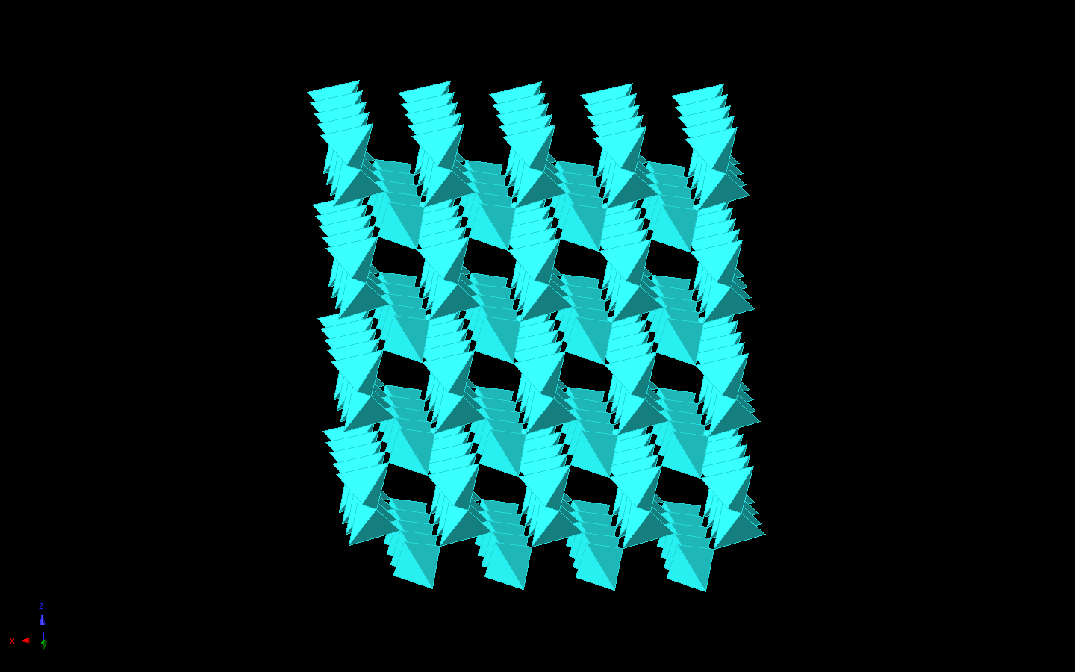

Slide 35
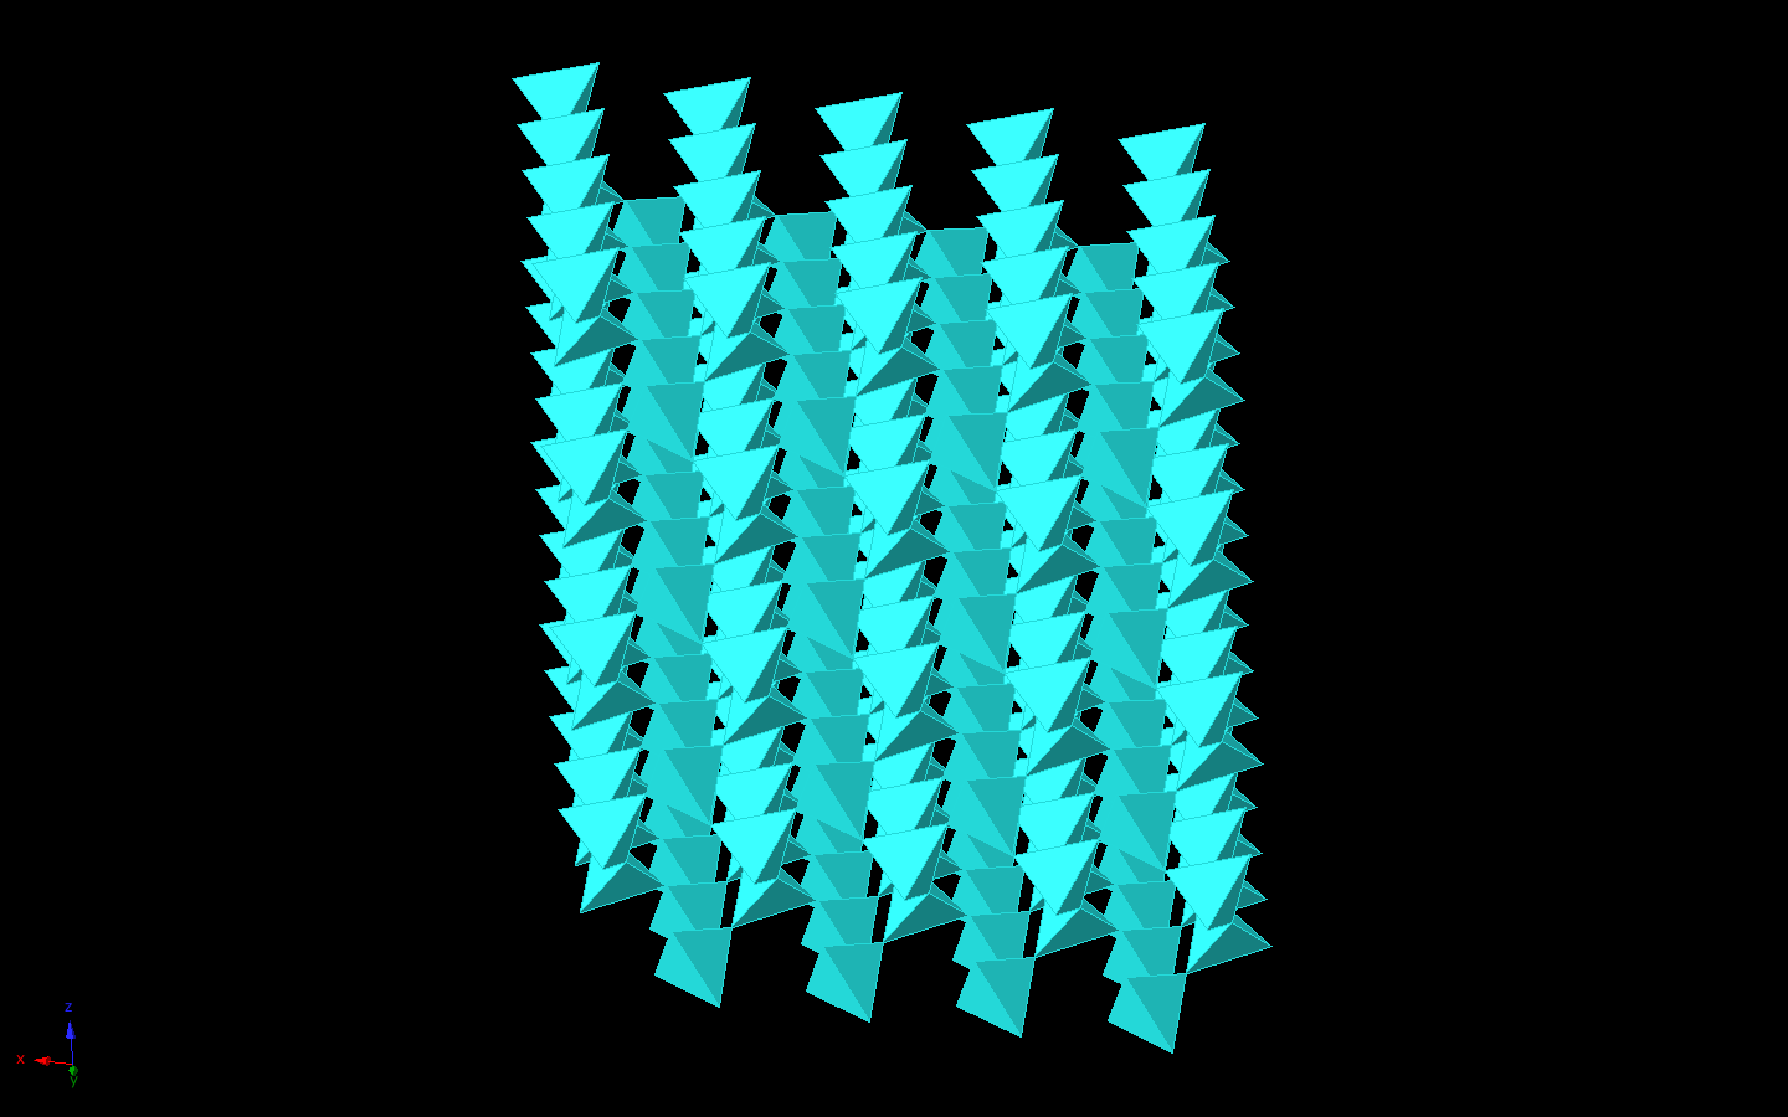

Slide 36
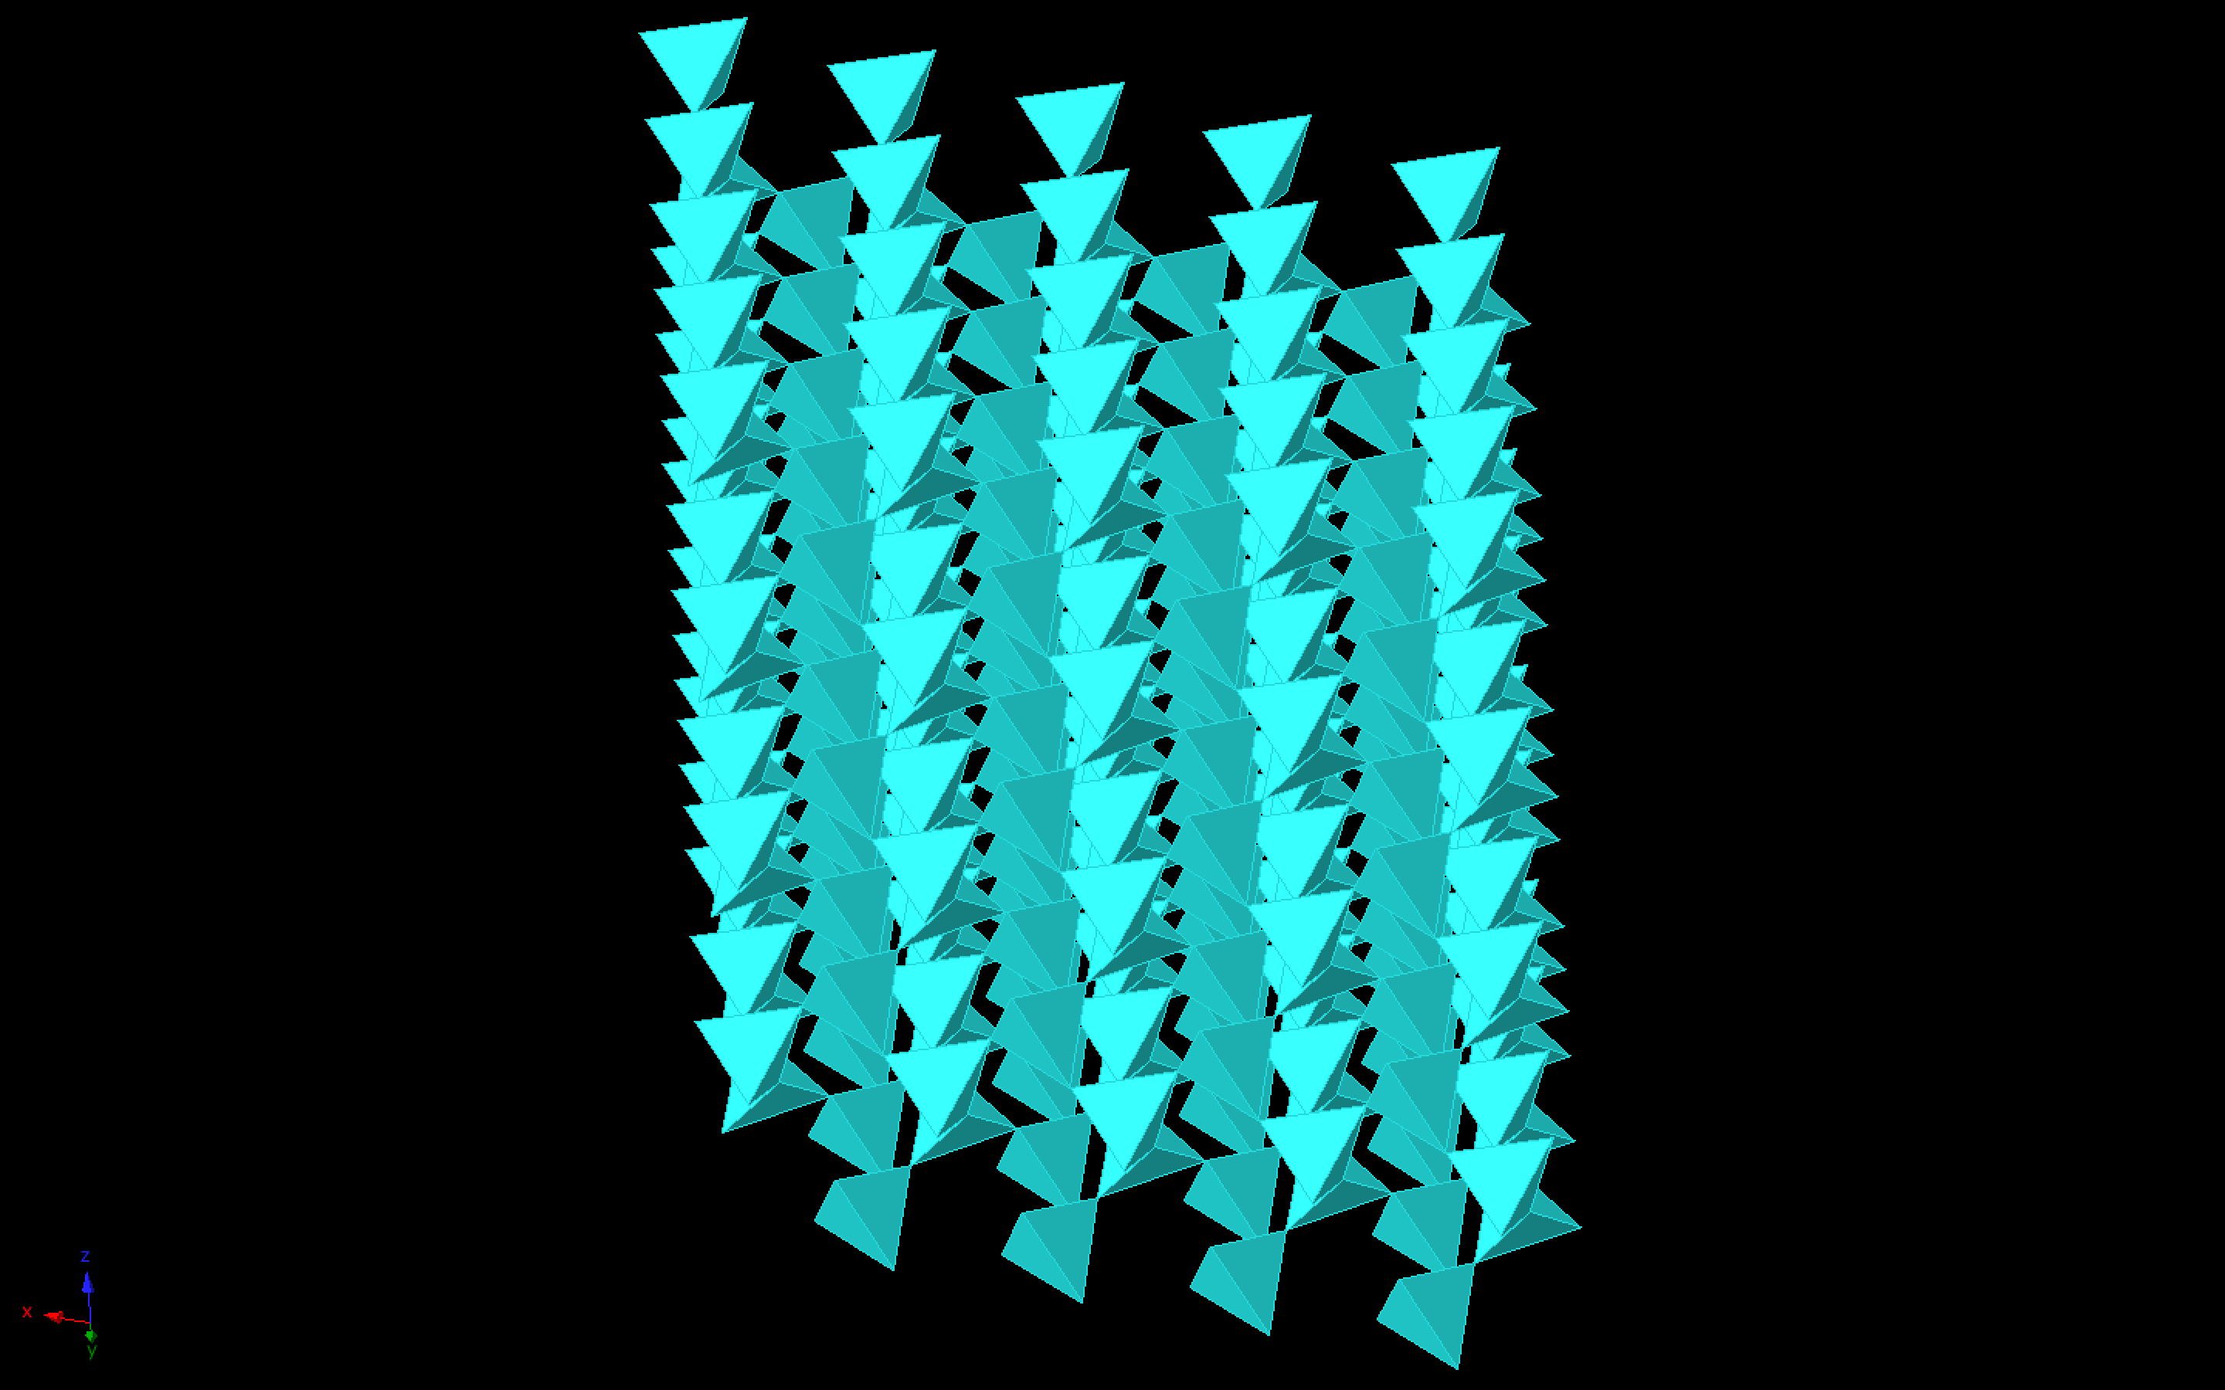

Slide 37
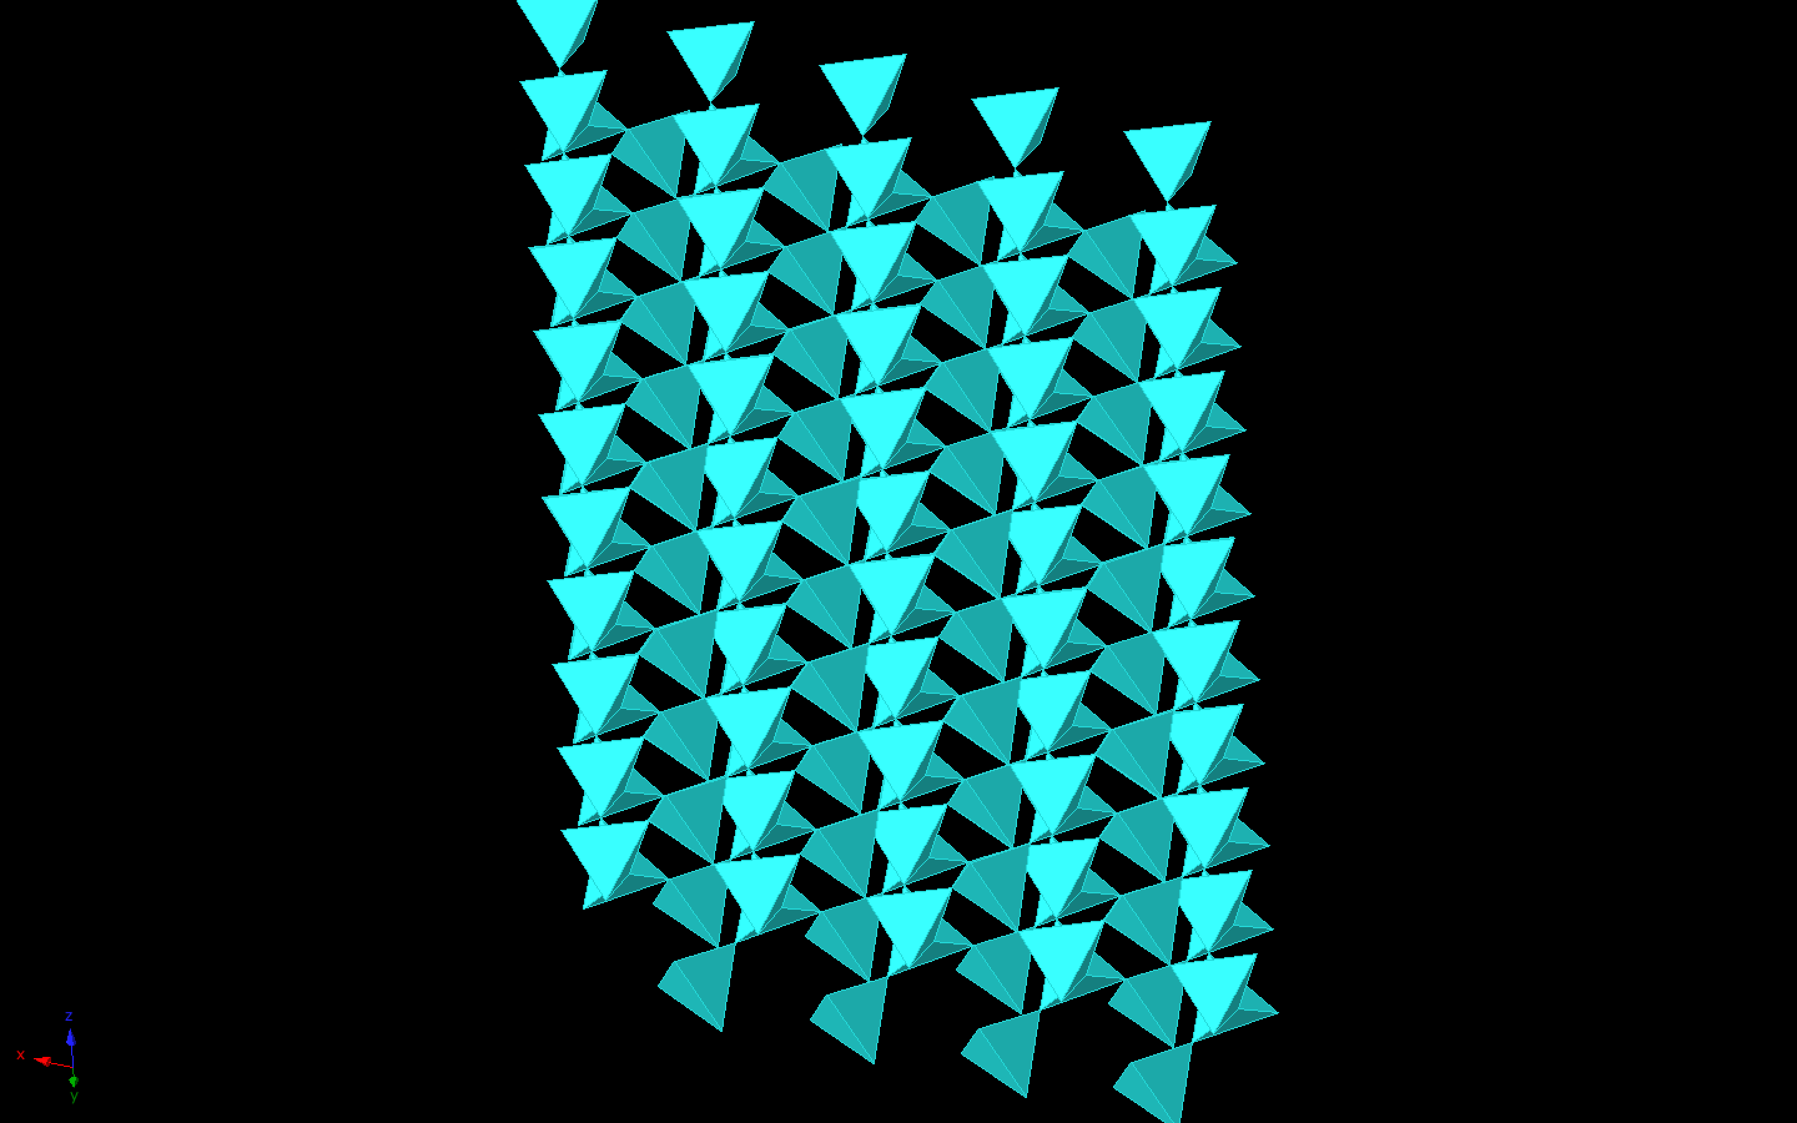

Slide 38
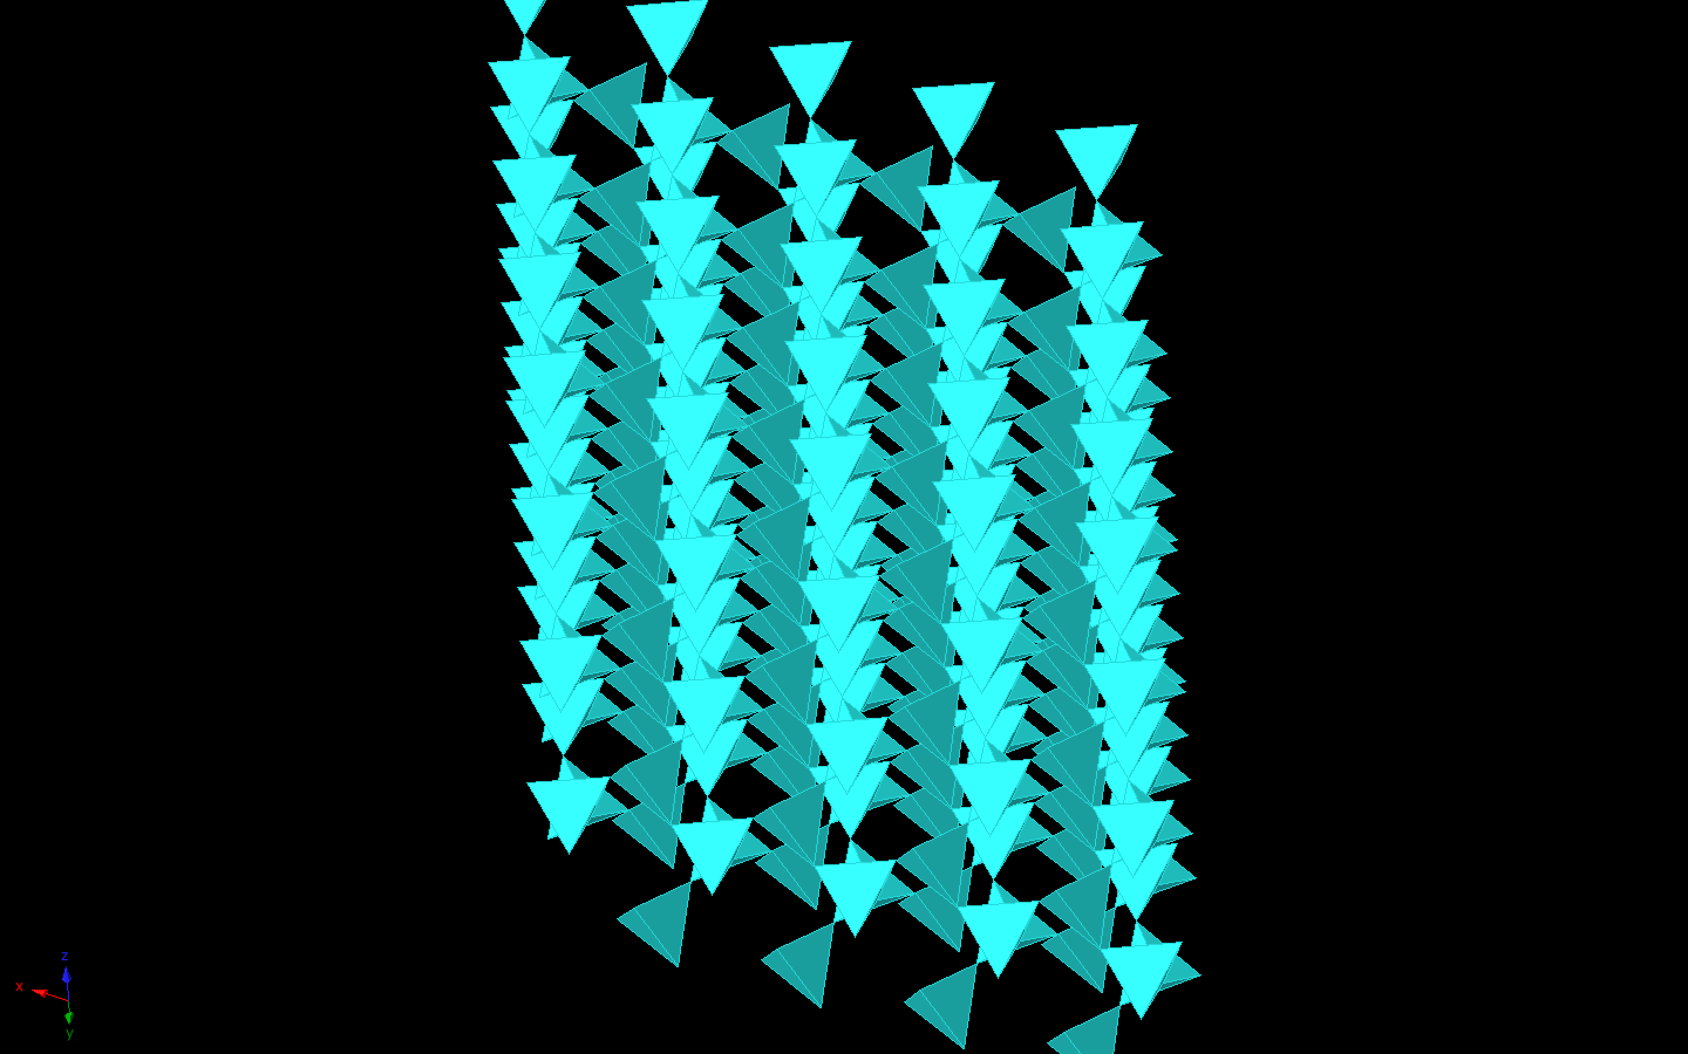

Slide 39
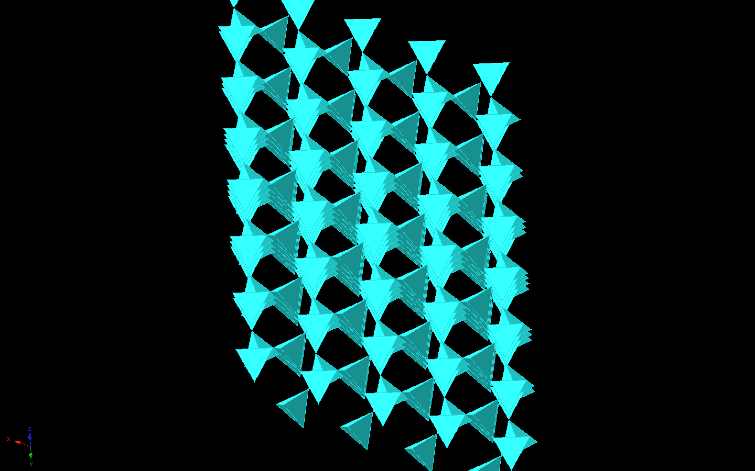

Slide 40
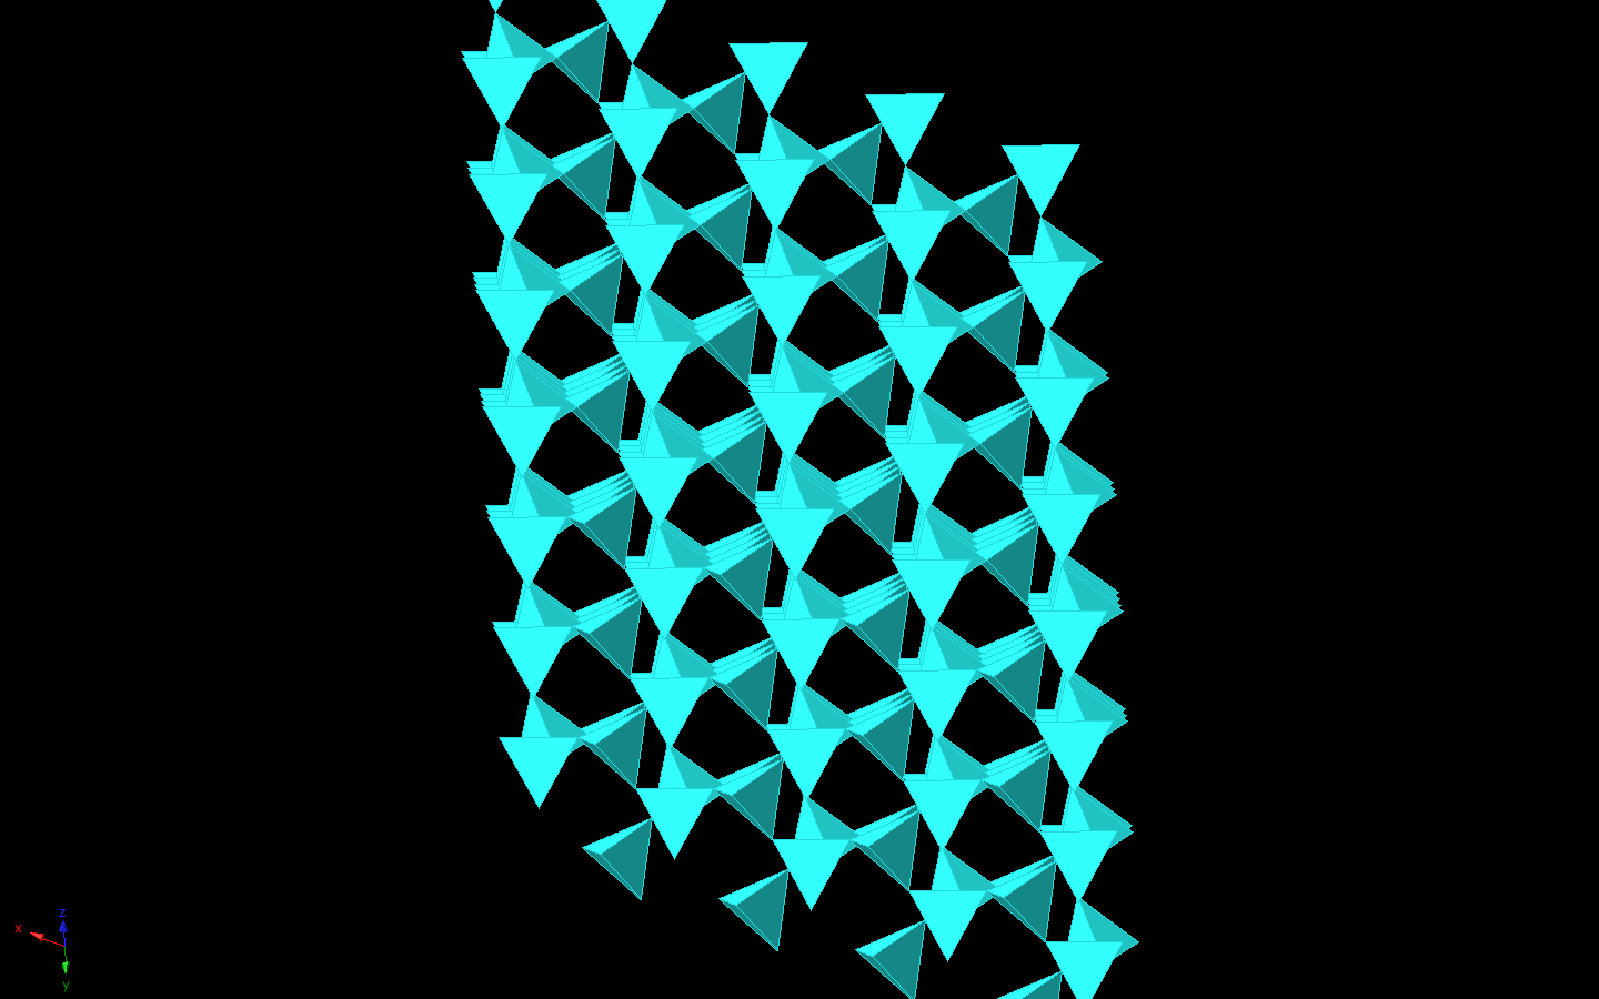

Slide 41
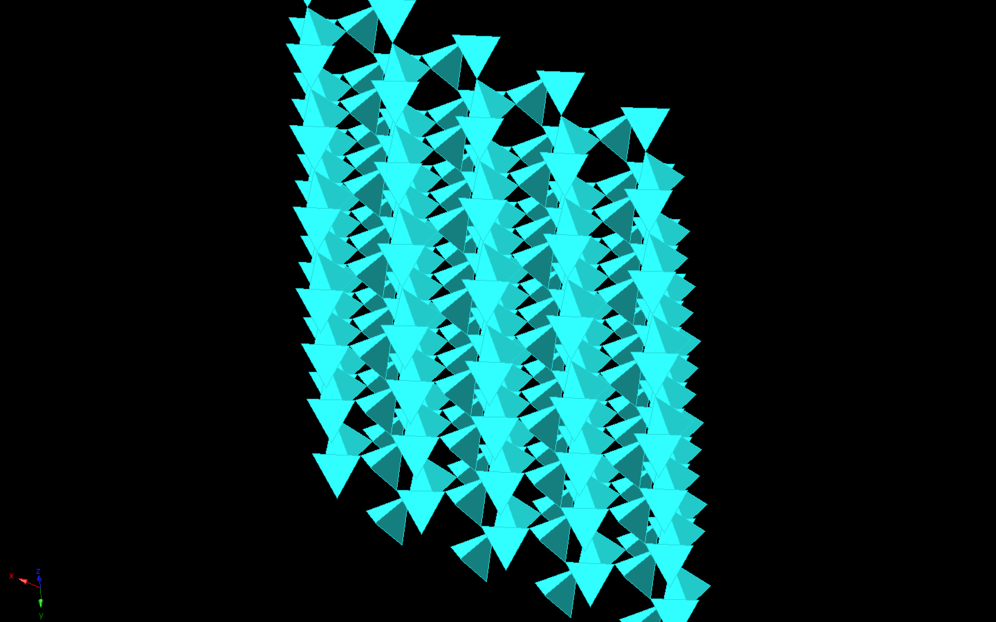

Slide 42
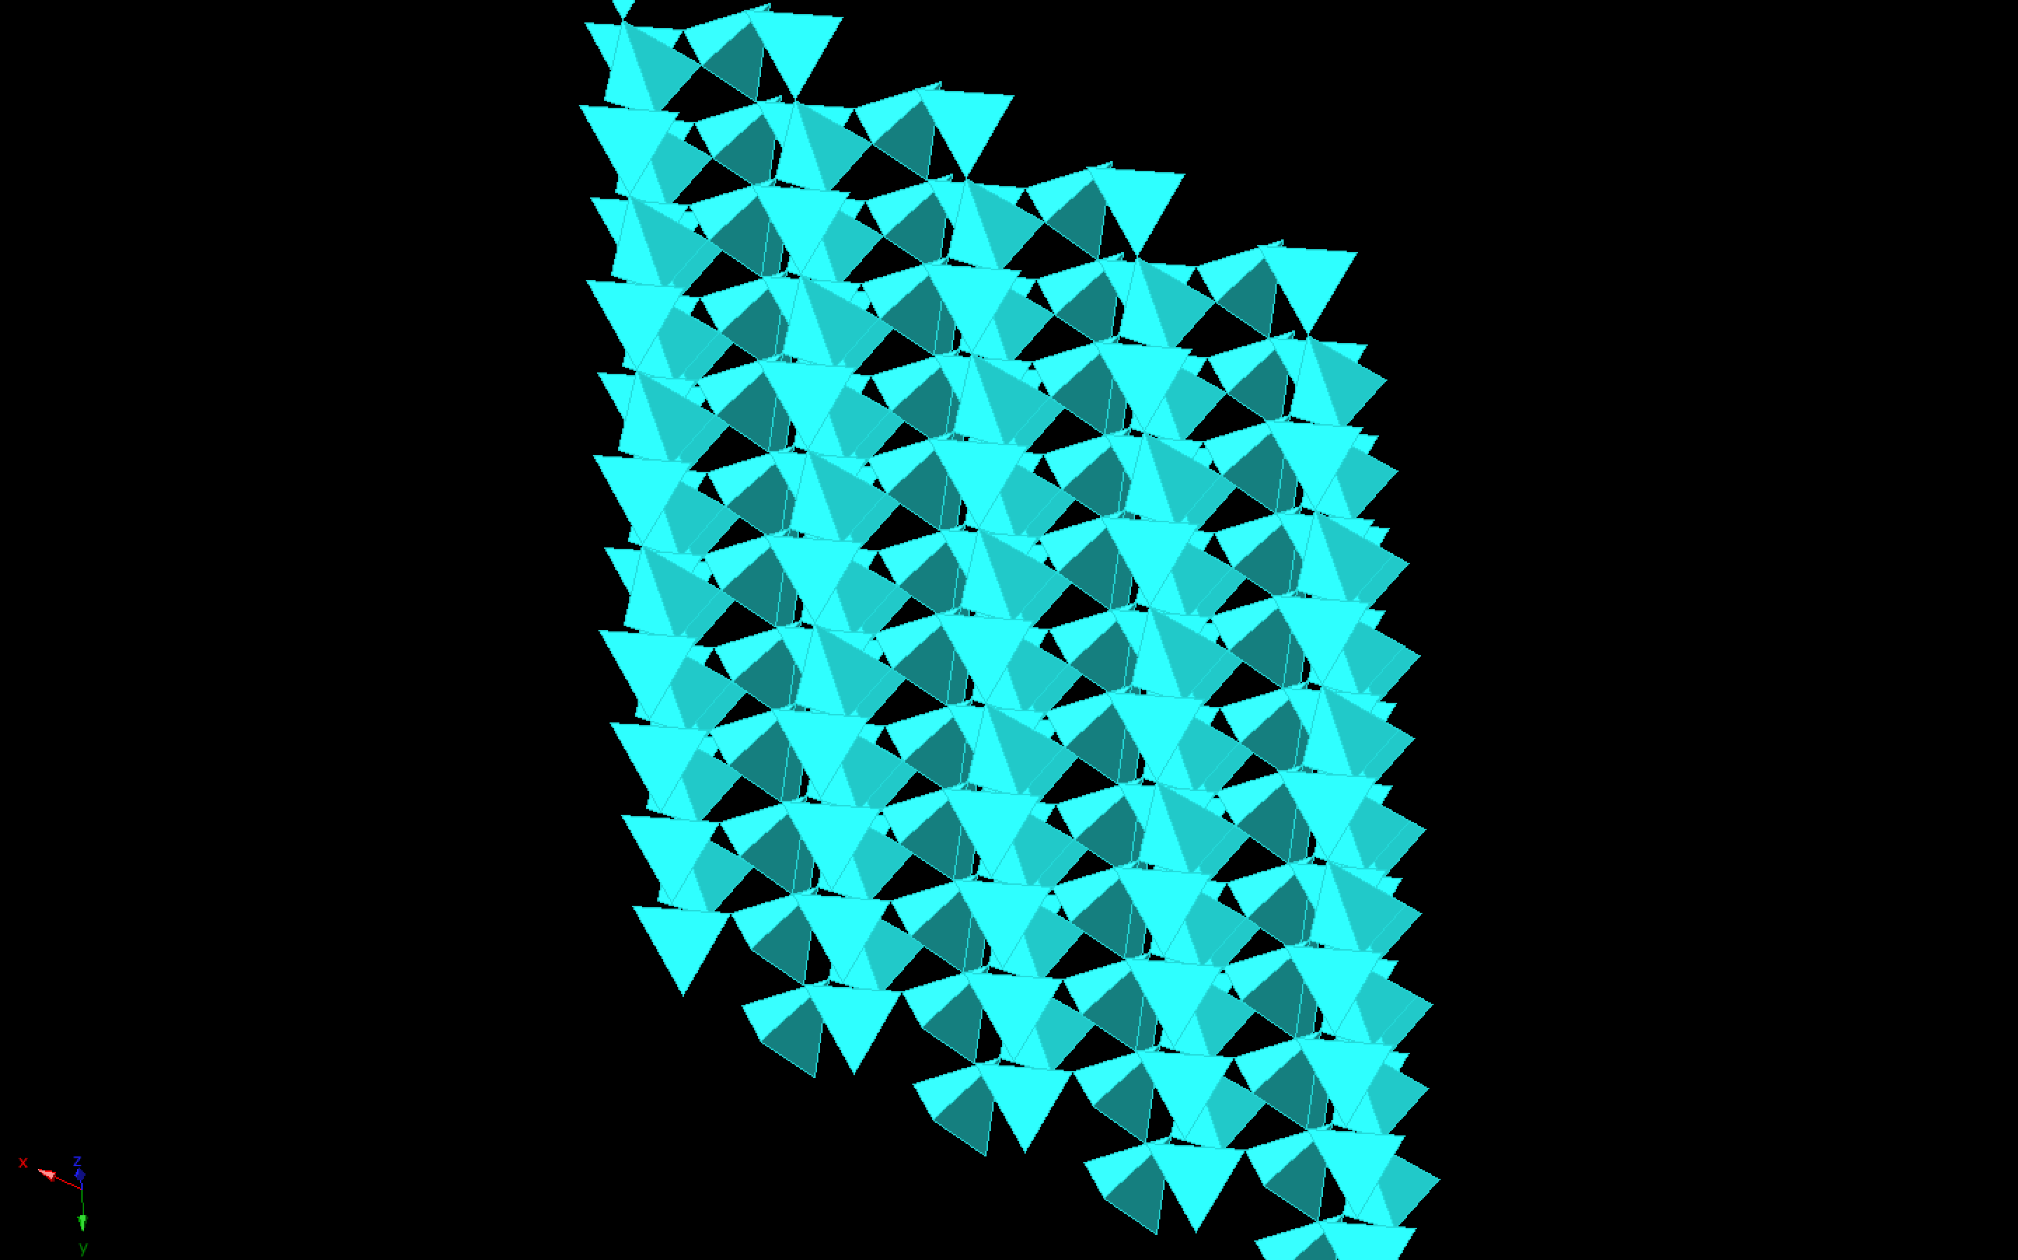

Slide 43
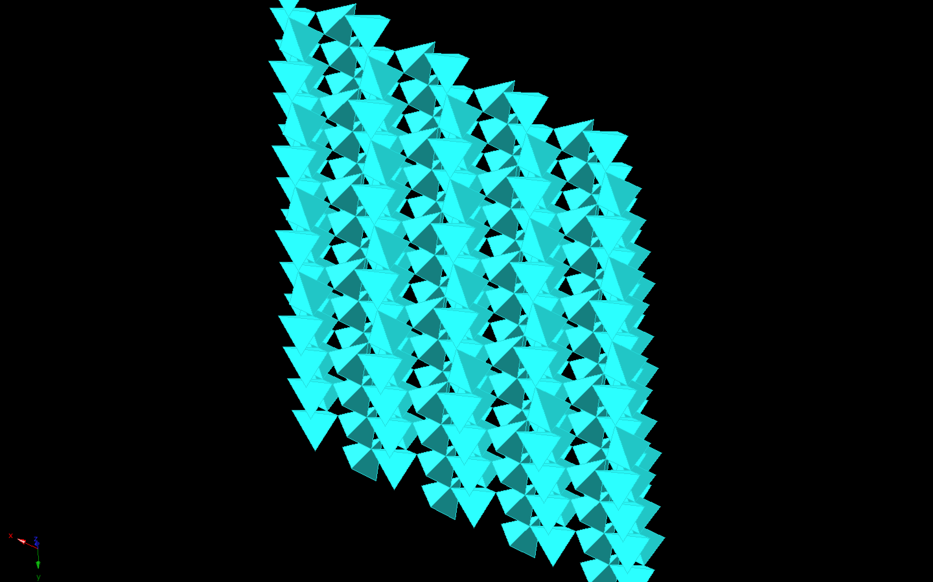

Slide 44
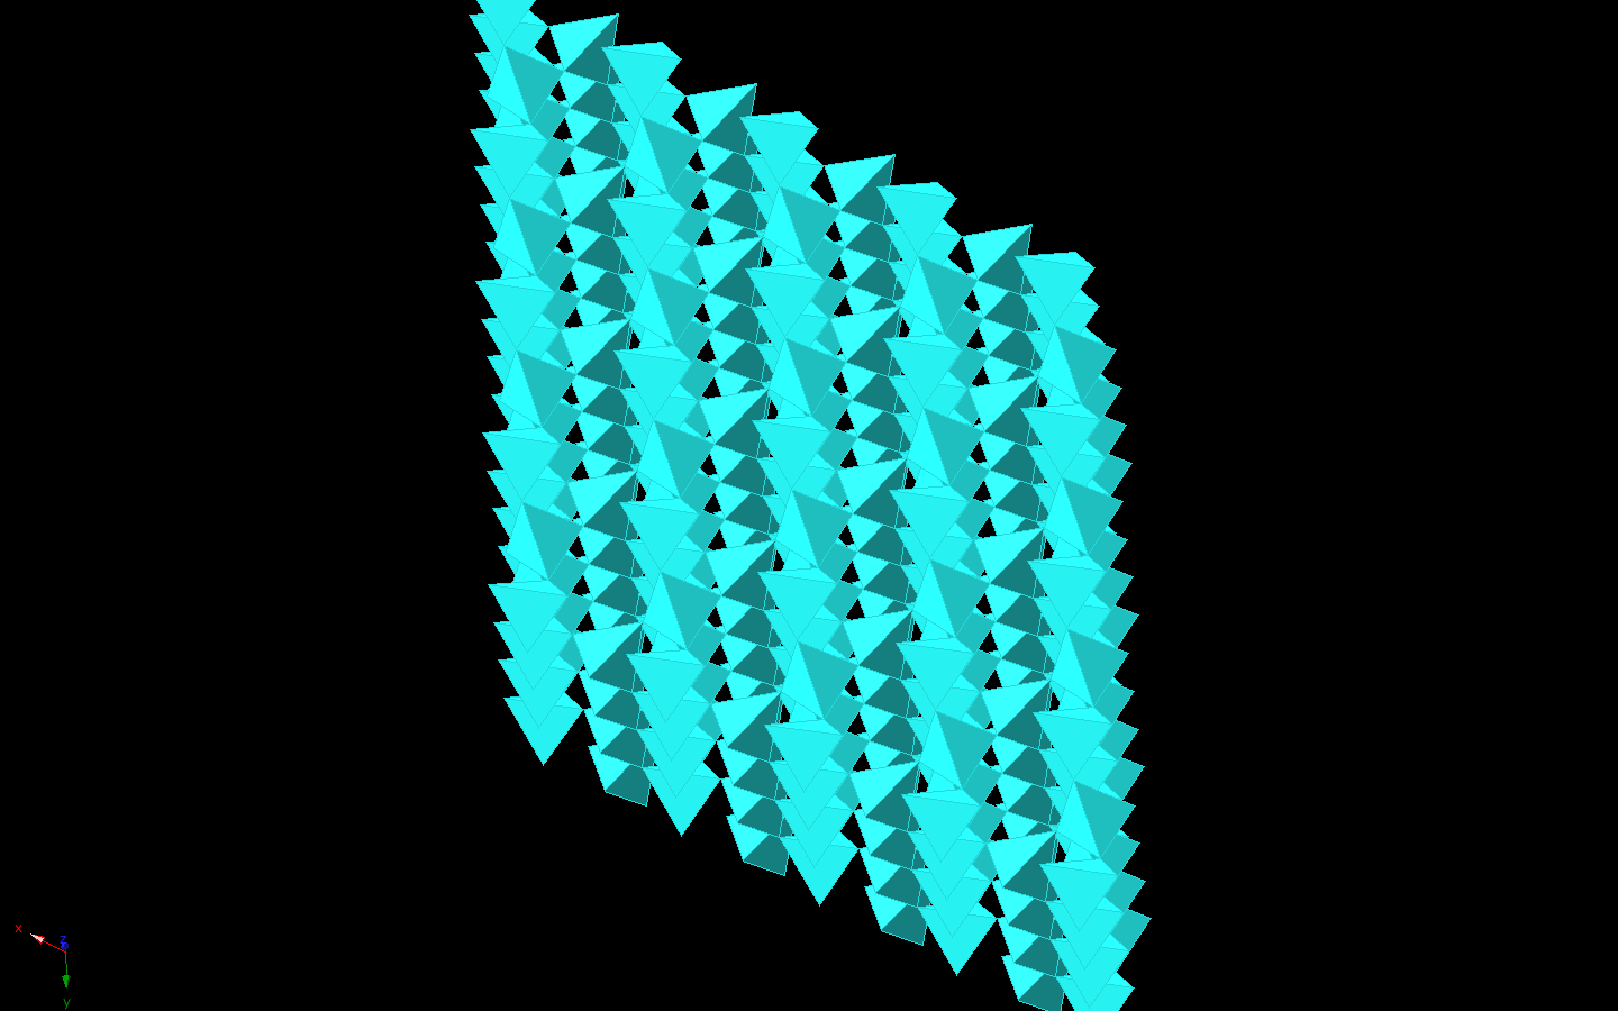

Slide 45
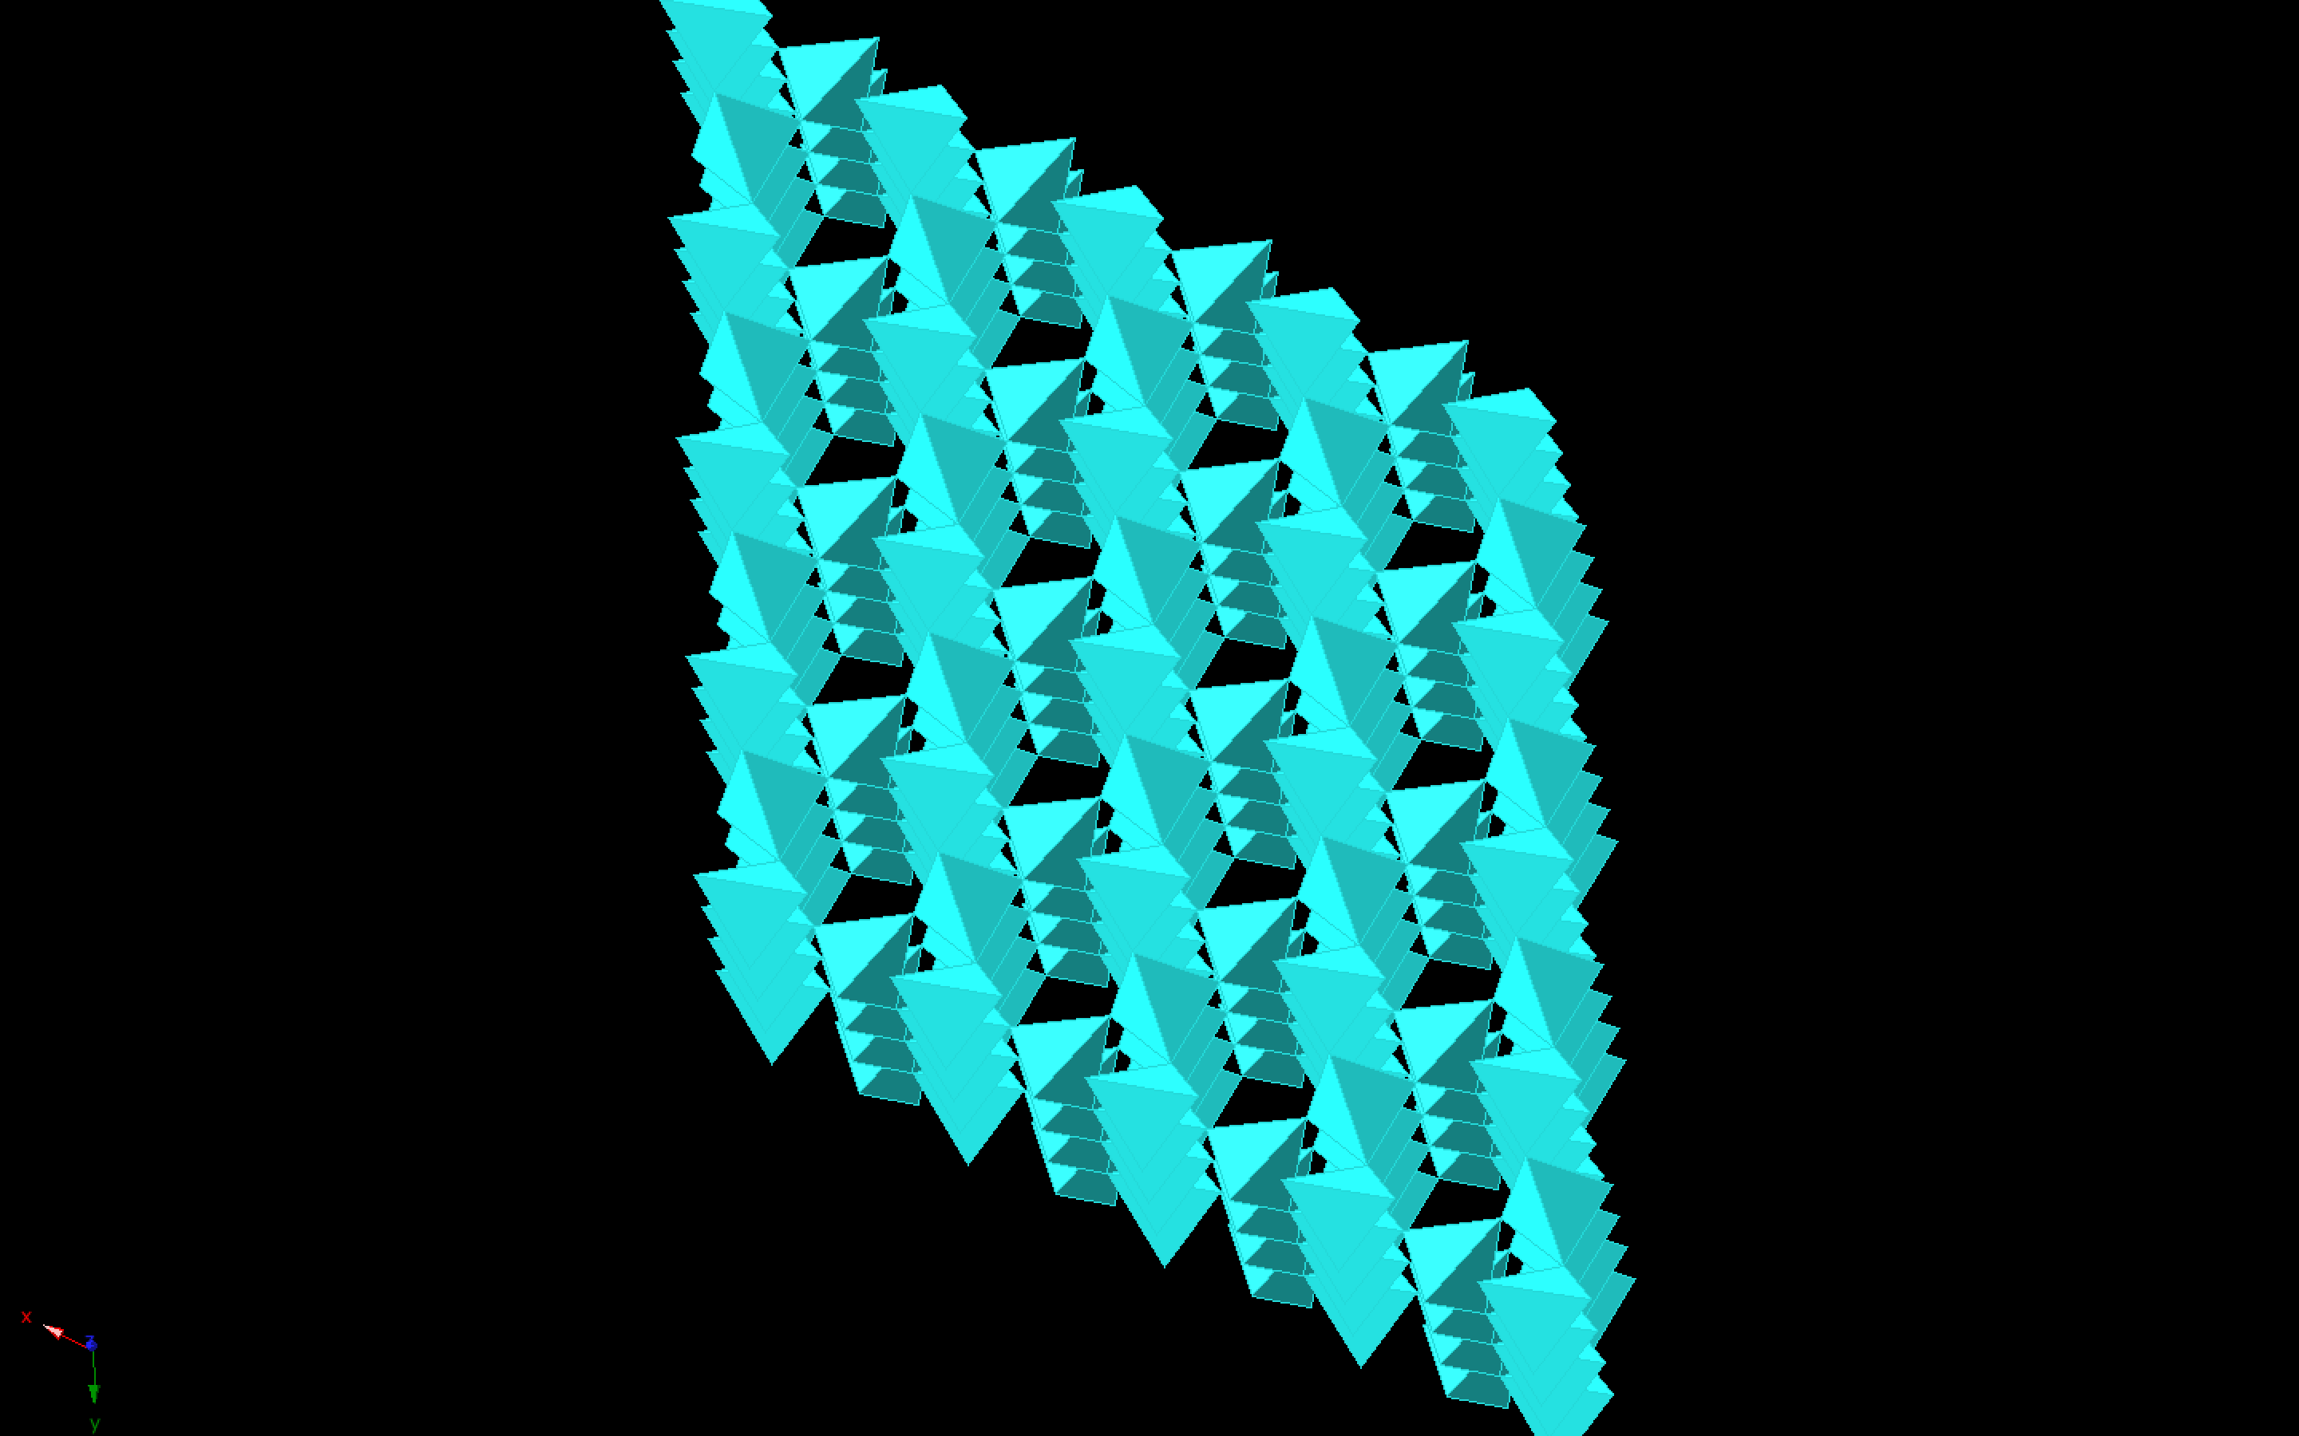

Slide 46
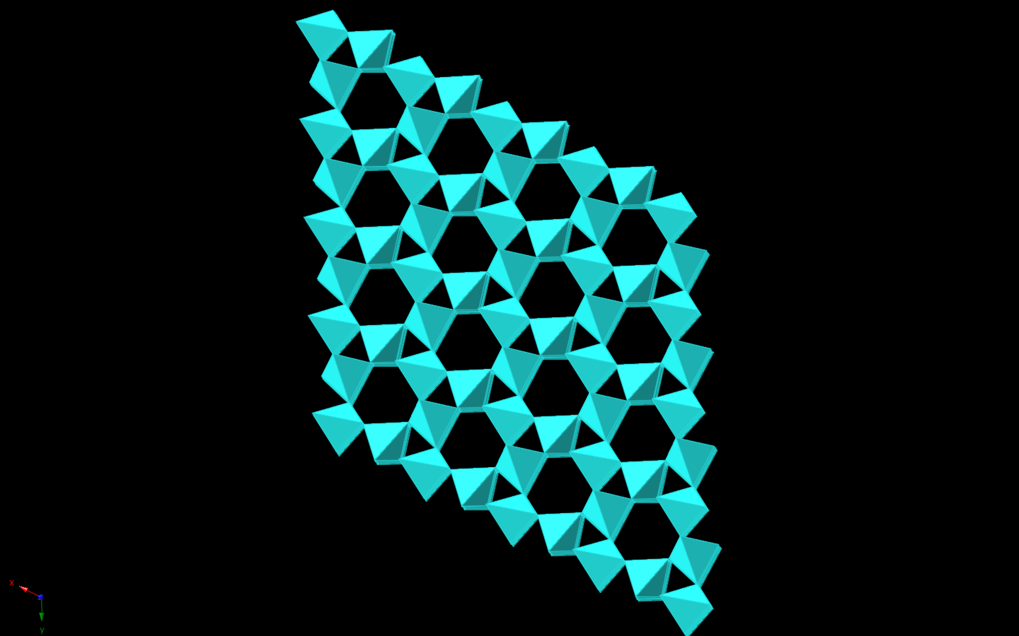
Looking Along Z-Axis

Slide 47
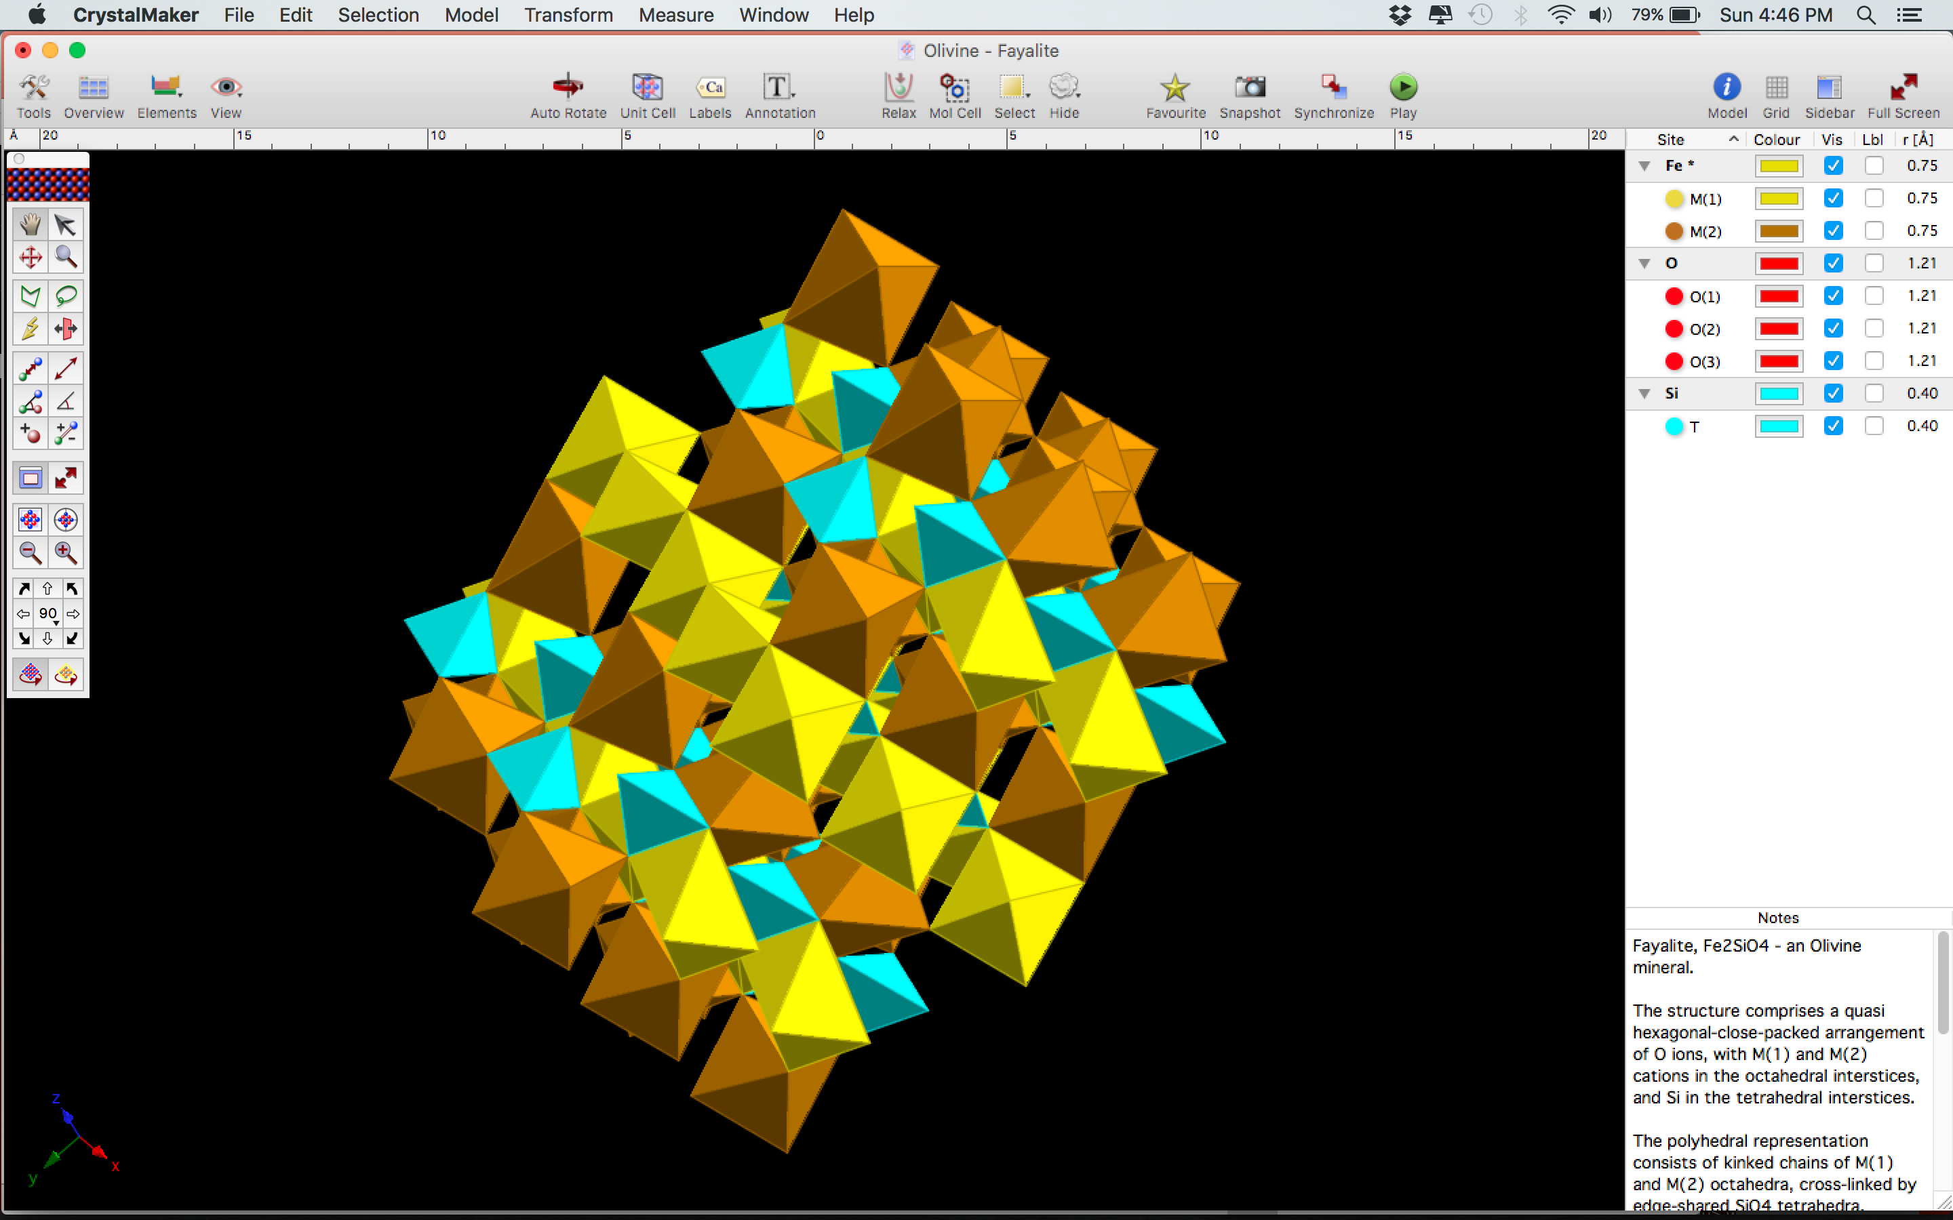
What Do We See?
Quartz has a very open structure, and is in 4-fold coordination with the oxygen atoms around it.
Looking along the different axes, we can see that quartz has big channels that run through the crystal.
Quartz has a density of ~2.65 grams per cubic centimeter.

Slide 48
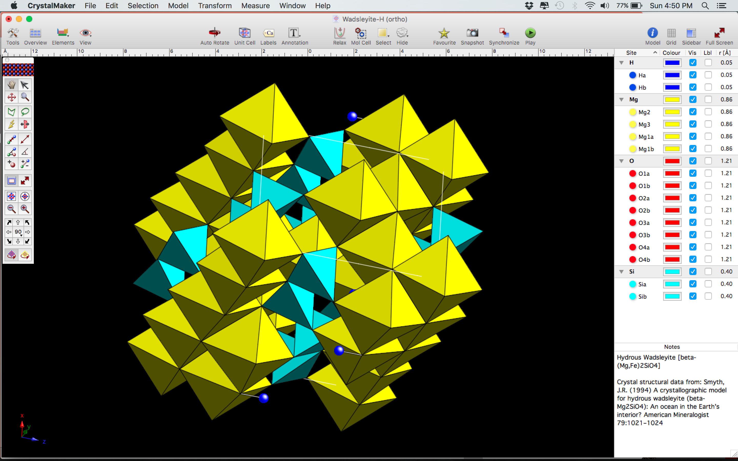
Now Let’s Look at the Density of Stishovite
Stishovite is a higher-pressure phase of SiO_{2.}
It is found in shocked rocks and within the high-pressure environments of the Earth’s mantle.

Slide 49
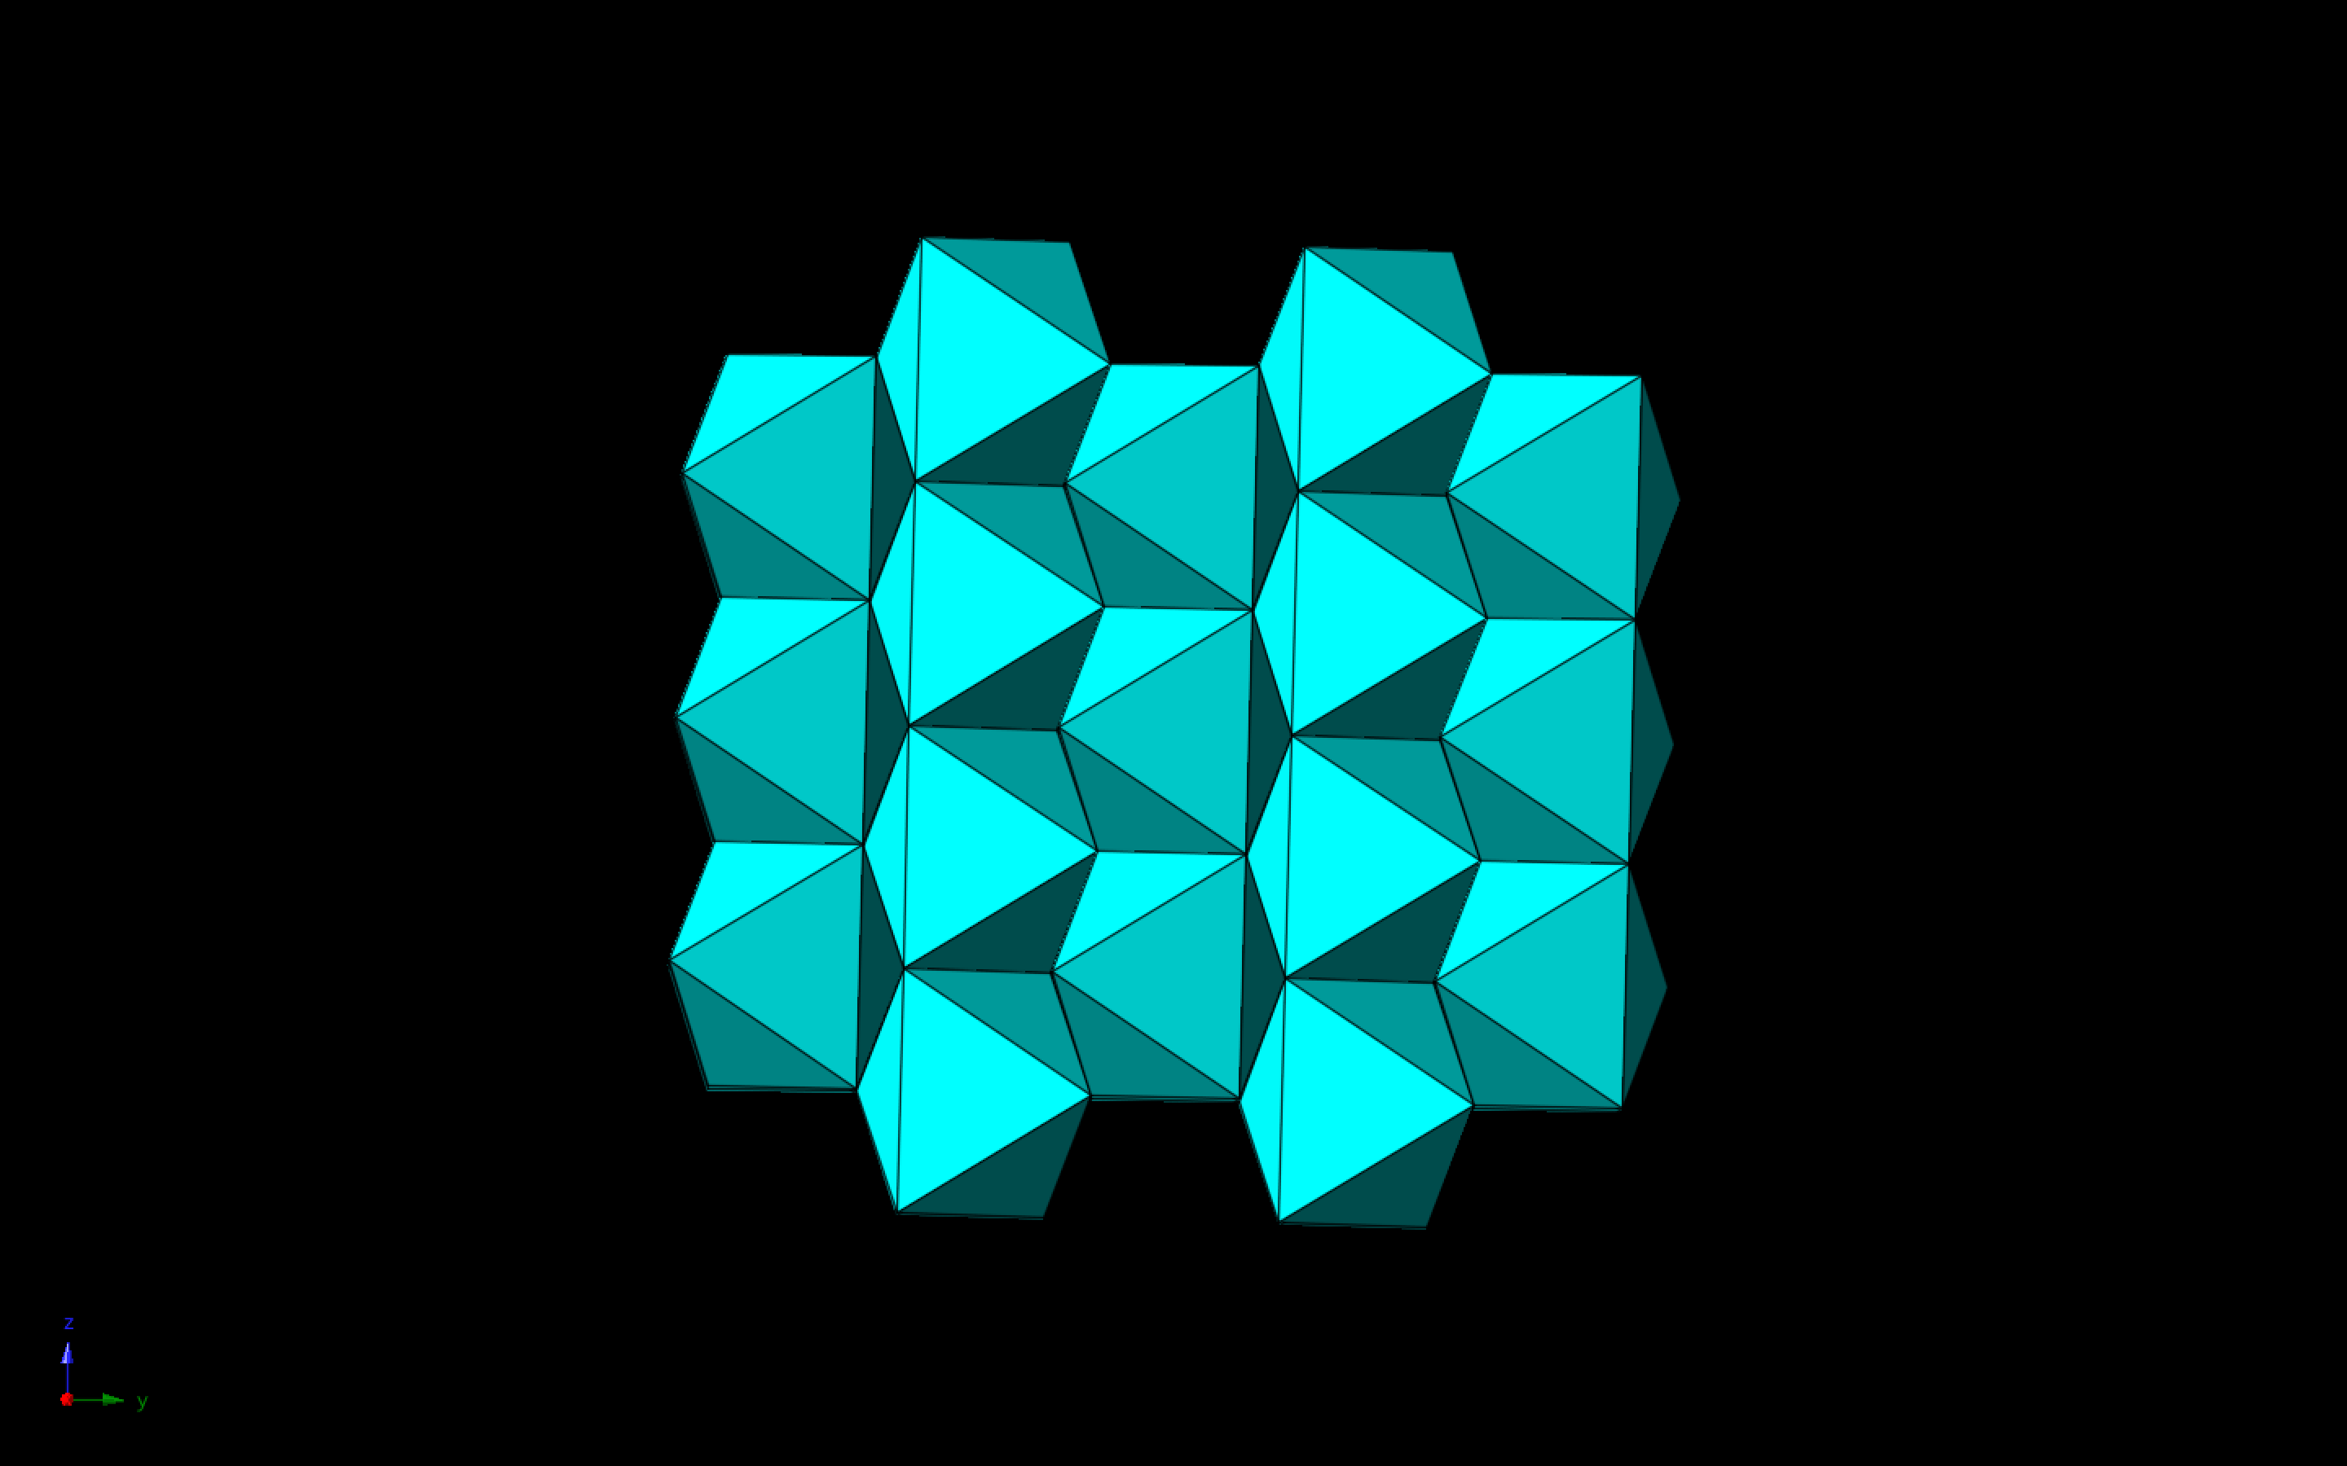
Looking Along X-Axis

Slide 50
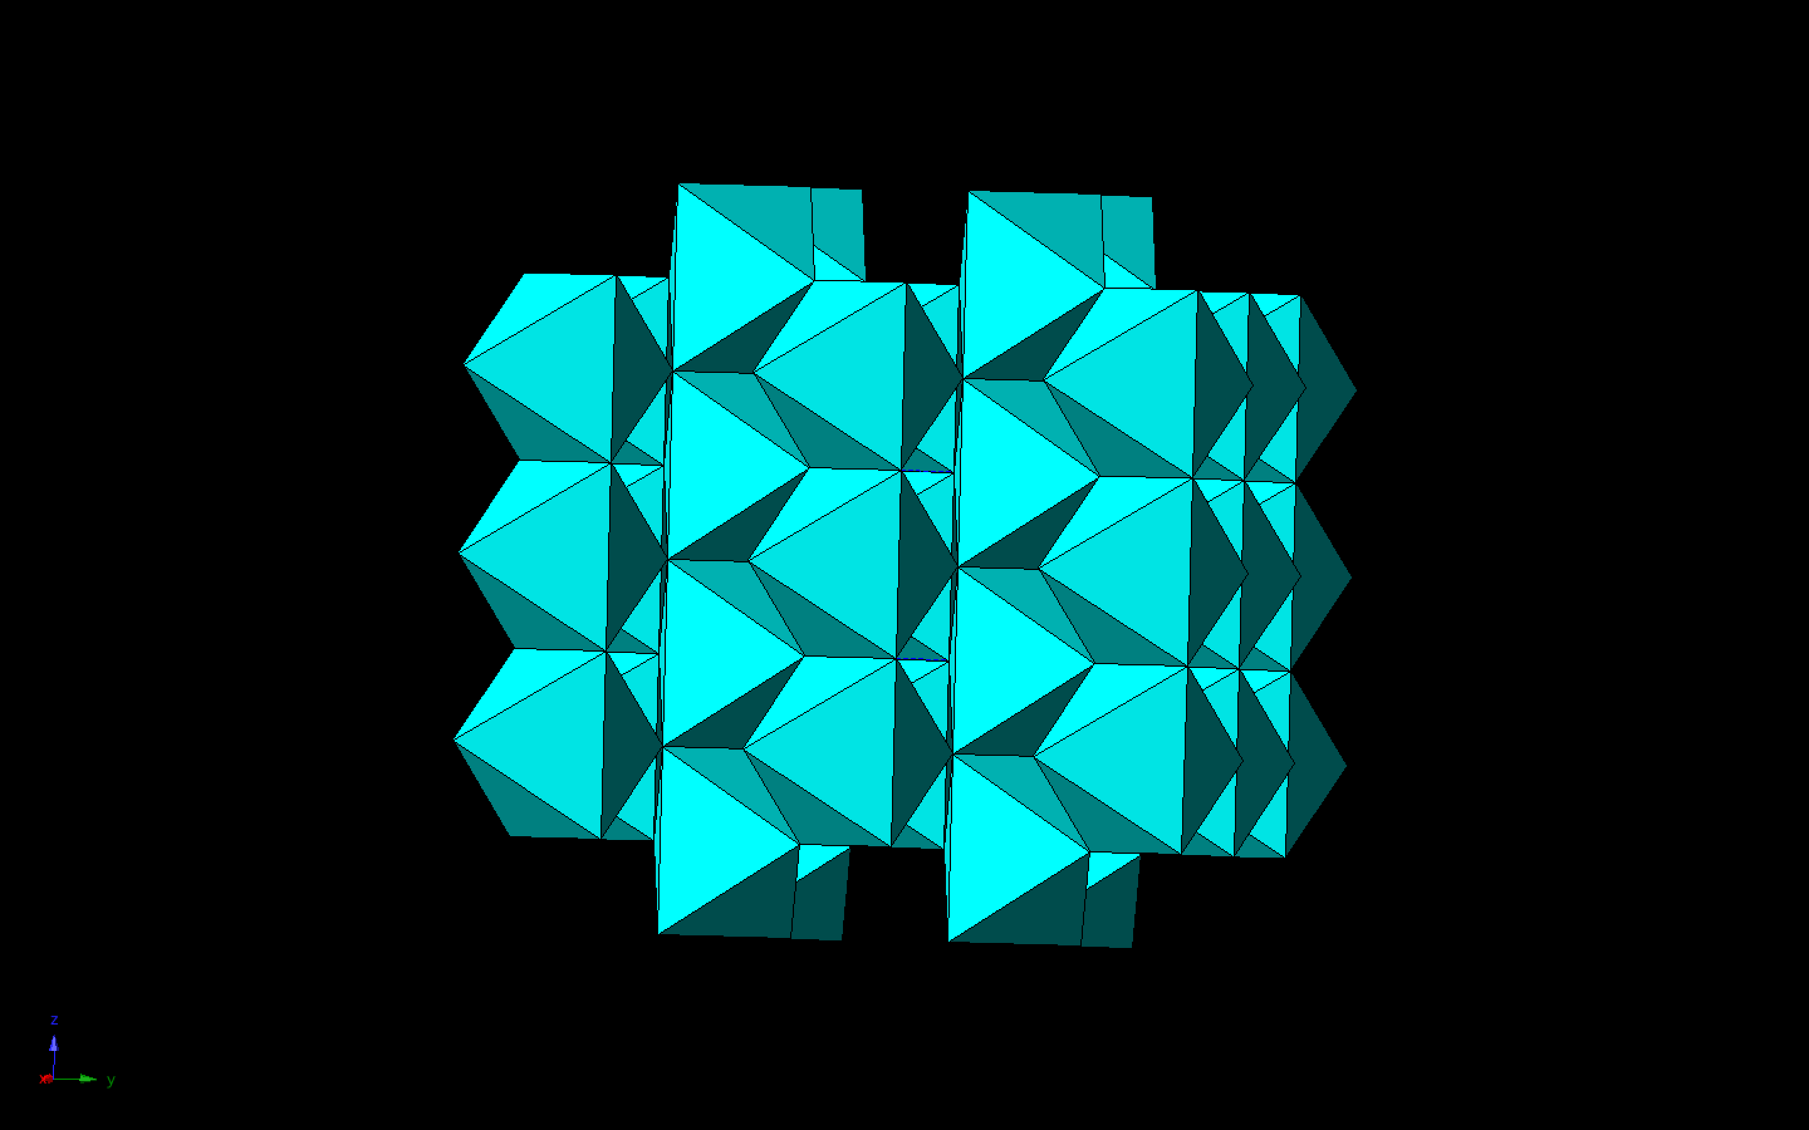

Slide 51
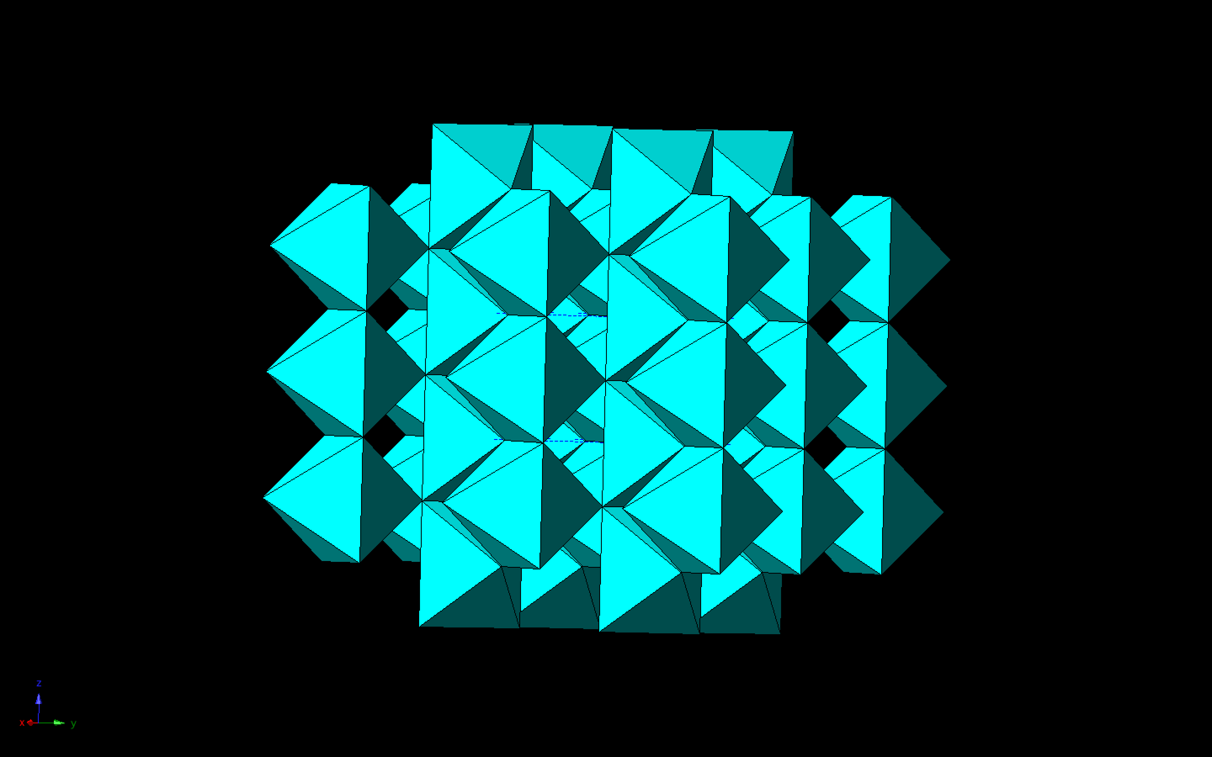

Slide 52


Slide 53


Slide 54


Slide 55


Slide 56


Slide 57

Looking Along Y-Axis

Slide 58


Slide 59


Slide 60


Slide 61


Slide 62


Slide 63


Slide 64


Slide 65


Slide 66


Slide 67


Slide 68

Looking Along Z-Axis

Slide 69

What Do We See?
Stishovite has a much more densely packed structure, and is in 6-fold coordination with the oxygen atoms around it.
We can see some channels running through the crystal structure, namely along Z, but the structure is much more dense.
The lack of big channels and the larger coordination results in an increase in density.
Density of Stishovite is ~4.35 grams per cubic centimeter, compared to ~2.65 for quartz.

Slide 70

Implementations So Far
We have shown presentations like this in the 3D Marston Exploration Theatre, where the theatre software lets us fly through the crystal.
Seems to be successful with higher age groups, but we want to aim for more family-oriented audiences.
People seem to be initially drawn in with the “wow-factor” of the 3D software in rendering the minerals, but we can do more to keep the presentations more entertaining.

Slide 71

Future Application
We have to make presentations more kid-friendly.
Make the concepts more accessible to kids, and keep their attention.
We can potentially use this software in Geology-101 and Mineralogy classes, where students can learn about some of the different macroscopic attributes determined by it’s microscopic properties.
Ultimately, we want to be able to zoom to different places over the Earth and look at different rocks and surfaces.
Could expand to a solar system scale, where we can look at ice structures in the moons of the outer solar system.

Slide 72

Acknowledgements
ASU-NASA SpaceGrant, for being Champs and providing students with such amazing opportunities.
My SpaceGrant Mentors, Dr. Tom Sharp and Dr. Dan Shim, for being Saints and letting me do some really fun and rewarding research.
My fellow SpaceGrant Fellows, for being Bros and an awesome community of friends.
My girlfriend Brooke, for being a Boss and doing everything I can’t.
She couldn’t be here today, she won $1000 from the School of Earth and Space Exploration to go restore register boxes in caves around Payson… You know, cause she’s a Boss!

Slide 73

Thank you! Questions?

